Slide 1
Mixed Attainment Maths Conference (London IoE) Workshop on Saturday 26th January 2019 Visible Maths Pedagogy Tiago Carvalho/Alba Fejzo Stoke Newington School London Borough of Hackney
www.visiblemathspedagogy.wordpress.com
Pete Wright UCL Institute of Education pete.wright@ucl.ac.uk @PeteWrightIOE www.maths-socialjustice.weebly.com
Notes:
Duration - 1 minute

Slide 2
Structure of workshop
Modelling one of the strategies used (Tiago – 15 mins):
Audience play the role of students
Rationale for ‘Visible pedagogies’ project (Pete – 5 mins)
Overview of Visible Pedagogies Project (Alba – 15 mins):
Context at Stoke Newington School
Maths department development aims
The six strategies used so far
Evidence and evaluation
Development & Dissemination
Findings; underlying research; methodology. (Pete – 10 mins)
Discussion (All – 10/15 mins)
Notes:
Hello, etc.
We will start with a short activity and we will talk

Slide 3
Think – Pair – Share Activity
You will play the role of students
Assume you can use your subject knowledge
Think – 1 minute
Pair – 2 minutes
Share – 3 minutes
Be prepared to present your partners’ ideas
Notes:
For this activity, in a moment I will put a problem for you to solve on the board
You will play the role of students
But you may assume you can use your subject knowledge
Also, after the TPS we will have a discussion about the activity as we

Slide 4
Think – Pair – Share
Think about how you would find the proportion shaded in each colour
Is there more than one way of doing it?
Notes:
If someone asks, they can make the assumptions they deem necessary to approach the problem. Reflect if they’re necessary or not.

Slide 5
Discussion
Why do I ask you to present your partner’s ideas and not your own?
Notes:
TPS
Why do I ask you to present your partner’s ideas and not your own?
Why might it be important to listen?
Table
What is the difference between the two sides of the table?
What does the left / right side represent?
Why might it be important to separate the two?
Scribing
Why do you think I wrote on the board exactly what you said even if it was wrong?
Why might it be important?

Slide 6
Discussion
Why do I ask you to present your partner’s ideas and not your own?
Why might it be useful to listen to and express other people’s ideas?
Why is that important?
Notes:
Let’s discuss ideas as a group
“Adam” how did your partner propose to tackle this problem?
Did you agree? Did you have a different method? Did you have any comments? Did your partner lay out the work in a different way?
What information would you need to have to answer this question?
Once we’ve stepped out of the role-play, draw their attention to the need for this strategy being that students were not always giving these types of responses. (missing the point/not realising)
This response was not the response we had initially from our students
Before we tell you more about our student’s initial responses, we would like to introduce the project

Slide 7
The ‘Visible pedagogies’ research project
The project is based upon the following argument:
School mathematics in its present form contributes towards the reproduction of inequities in society.
Progressive pedagogies’ have the potential to address the attainment gap through raising motivation and engagement.
In progressive classrooms, the learning is less structured and the ‘rules of the game’ (‘recognition/realisation rules’), that students need to follow in order to succeed, are less clear.
There is a danger that less wealthy students are further disadvantaged by open-ended approaches to learning maths.
This project therefore, whilst embracing mixed attainment grouping and progressive approaches to teaching, explores ways to make the rules of the game more explicit to learners.
Notes:
Duration - 1 minute

Slide 8
Context of Stoke Newington School
Inner London school; 29% PPI students
Target group – BCRB (Black Afro-Caribbean Boys) underachievement is a priority
Oracy (part of School Improvement Plan/TPS/never heard the word)
Maths dept. is gradually moving to mixed attainment
- 2017-2018 introduced this to year 7s
- 2018-2019 extended to year 8
- 2019-2020 extend this to year 7/8 and 9
Collaboratively planning mixed attainment lessons (SOW)
Established a timely collaboration with Dr. Pete Wright from UCL (IOE)
Notes:
We ensured that BCRB target group was represented and the focus of our study.
At the same time we started this project with Pete, which was very timely given the priorities of the school (closing the gap of PPI/BCRB) and the shift to mixed attainment

Slide 9
The five strategies used so far
Sharing your partner’s thinking through TPS
Separating reasoning from working by using a table
Scribing for students when presenting ideas
Sorting/classifying problems into different types
Card sort to make teachers’ intentions explicit
Notes:
2 cycles of the project so far:
Each cycle included planning, delivering, evaluating
Cycle 1: first 2 strategies
Cycle 2: last 2 strategies

Slide 10
Strategy 1. Sharing your partner’s thinking through TPS
“Why do you think the teacher asked you to explain your partner’s thinking and not your own?”
“I think it was to see if you listen to your partner”
“to prove you listen”
“So if I don’t understand I can ask my partner for help”
“to test our listening skills”
“Because it helps you to understand different opinions on the maths problems and different paths to the answer”
“Because you can get two different perspective[s] and it may help you finalise your idea”
Notes:
Responses came from surveys during first cycle; first responses
We asked students to share their partner’s thinking but we did not have a discussion about this
Instead we asked them to respond to a survey asking the question “Why do you think the teacher asked you to explain your partner’s thinking and not your own?”
Typical responses were…see slide
Since then, we have discussed the purpose of sharing your partner’s ideas (made the strategy explicit) and we have noticed that they have a better understanding and appreciation of the purpose of the activity

Slide 11
Strategy 2. Separating reasoning from working out by using a table
No prior discussion
Present student’s contributions on the board in a table
Ask students to name each side of the table
Students suggested calculations/working out vs explanations/method/why we’re doing what doing
Strategy 3. Scribing for students when presenting ideas
Write down exactly students say
Intention was to draw out
Ambiguities
Highlight informal language and discuss mathematical alternatives
Annotation
Ask students to improve solution and annotate in a different colour
Strategy 4. Sorting/classifying problems into different types
First discuss with students rationale for sorting
Ask students to sort problems into types 1/2/3
Strategy 5: Card sort to make teachers’ intentions explicit
Negotiated a model solution to an algebra problem. Students copied it down.
Discussed why we were doing it at the time
Students used a card sort to rank reasons and this generated a discussion
Notes:
Strategy 2 – have enough examples of each side of the table to make the point clear
Strategy 3 – we asked students “how could we annotate the solution to the problem that we had on the board?” We had an immediate discussion about the merits of annotating and scribing. We then gave them the opportunity to annotate their own solutions.
Strategy 4 – The types were described to students previously. We had the discussion about intention of strategy beforehand and therefore students were aware of the intention and had a buy-in, strategy was successful.

Slide 12
Evidence and evaluation
Surveys
Video recorded the lessons
Peer-observations
Interviewed target PPI students (audio recorded)
Developed a Protocol for video-stimulated recall
Reflective discussions
Evaluated the success of the strategies
Identified new strategies that we would like to try next
Notes:
We did the exact same lessons (first on area and second on ratio – jointly planned)
We interviewed 3 PPI students each
We followed up observations with reflective meetings
Fr

Slide 13
Initial findings from the project (1)
Recognising teachers’ intentions
At the beginning of the project, students commonly misinterpreted the teacher’s intentions, often attributing the teacher’s pedagogical choices to an attempt to better manage students’ behaviour.
After cycle 2, most students were beginning to recognize some (but not all) of the primary reasons for teachers’ pedagogical choices. The following examples relate to the strategy of scribing for students when presenting ideas:
Four of the six target students (Marcus, Sophia, Mary, Keira) appear to clearly recognise the primary purpose of identifying and addressing errors and misconceptions …

Slide 14
Initial findings from the project (2)
It was nice to like write down it, and then look at our mistakes. … Because of, then we can, like, fix the mistakes. … But usually people will like … if we make a mistake, and then they just change it. They just tell you it’s this, but they don’t tell you why … and then next time they do the same mistake. (Mary, interview)
It will be showing us that you think we’ve gone wrong a little bit. And by writing everything we’ve said, that will help, not just like the person, it will show everyone like where it went wrong. Instead of like you telling us, and that, we can learn from our mistakes. (Keira, interview)
Ennis demonstrated only a partial appreciation of this primary purpose whilst Neal was not able to articulate a valid purpose.

Slide 15
Initial findings from the project (3)
There was a similar pattern for other strategies with most students recognising at least one primary purpose, although also articulating some other valid purposes not considered primary by the teachers, and some invalid purposes.
Articulating success in learning mathematics
All six target students described experiencing success during the cycle 2 lesson.
Four of the six associated their success mainly with the number of questions completed and getting the answers correct, or with positive behaviour:
I did pretty well, I got the starter correct … I didn’t get to complete the ratio and flags one, but I got like to the second to last question. And then, with the sharing, I got them correct. (Sophia, interview)

Slide 16
Initial findings from the project (4)
I think I did good … I got all of the answers correct, from the ones that I did do. And I wasn’t getting distracted, so yeah. (Marcus, interview)
Two target students appeared to associate their success more with engaging with the progressive teaching strategies adopted by their teachers:
Well, I did pretty good … like because me and [another student] … we did our own separate question. And then after we just worked it out together, after, to see if how we got the same answer, and then what method we did and see what’s the easier method. (Neal, interview)
I think I did really good, because I was like annotating in my work … when you were telling us to annotate, and like … everything you did, like, I was doing as well. (Keira, interview)

Slide 17
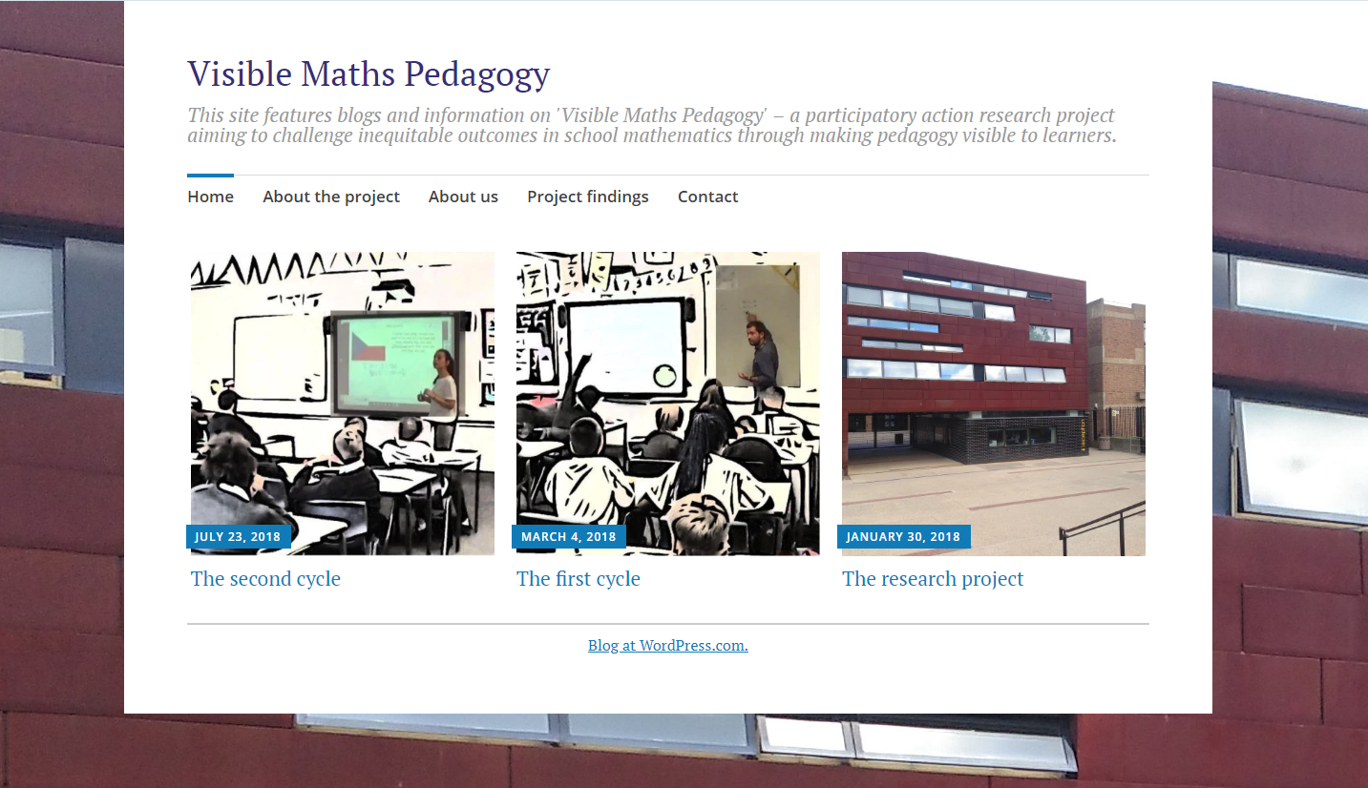
Designated website for the project
Check our website for future developments and dissemination:
further information; blogs; presentations; journal articles.
www.visiblemathspedagogy.wordpress.com
Thank you … Any Questions or Comments?

Slide 18
References to research underlying the project
Bernstein, B. (2000). Pedagogy, symbolic control and identity: Theory, research, critique (Revised ed.). Lanham, Maryland: Rowman & Littlefield Publishers.
Boaler, J. (2008). Promoting ‘relational equity’ and high mathematics achievement through an innovative mixed-ability approach. British Educational Research Journal, 34(2), 167-194.
Jorgensen, R. (2016). The elephant in the room: Equity, social class, and mathematics. In P. Ernest, B. Sriraman, & N. Ernest (Eds.), Critical mathematics education (pp.127-146). Charlotte, NC: Information Age
Lubienski, S. (2004). Decoding mathematics instruction: A critical examination of an invisible pedagogy. In J. Muller, B. Davies, & A. Morais, Reading Bernstein, researching Bernstein (p.91-122). London: Routledge.
Wright, P. (2016). Social justice in the mathematics classroom. London Review of Education, 14 (2), 104-118.
Wright, P. (2017). Critical relationships between teachers and learners of school mathematics. Pedagogy, Culture and Society, 25(4), 315-330.

