Slide 1
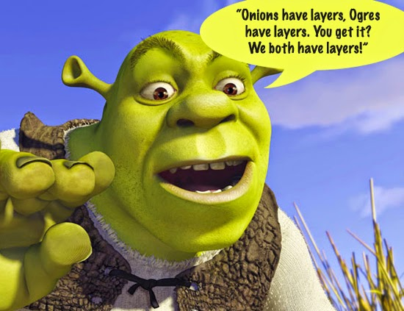
Differentiation is not a dirty word
Megan Bailey, St. Marylebone CE School

Slide 2
9999 + 999 + 99 + 9 + 5 =
0.62 x 37.5 + 3.75 x 3.8 =
( 4 + 1 ) + ( 5 + 1 ) + ( 6 + 1 ) + ( 7 + 1 ) + (8 + 2 ) =
5 6 6 7 7 8 8 9 9 10
What are you attending to?

Slide 3
9999 + 999 + 99 + 9 + 5
= (9999 + 1) + (999 + 1) + (99 + 1) + (9 + 1) + 1
= 10000 + 1000 + 100 + 10 + 1
= 11111

Slide 4
0.62 x 37.5 + 3.75 x 3.8
= 0.62 x 10 x 3.75 + 3.75 x 3.8
= 6.2 x 3.75 + 3.75 x 3.8
= (6.2 + 3.8) x 3.75
= 10 x 3.75
= 37.5

Slide 5
( 4 + 1 ) + ( 5 + 1 ) + ( 6 + 1 ) + ( 7 + 1 ) + (8 + 2 ) =
5 6 6 7 7 8 8 9 9 10
5
4 + 1 + 5 + 1 + 6 + 1 + 7 + 1 + 8 + 2 =
5 6 6 7 7 8 8 9 9 10

Slide 6
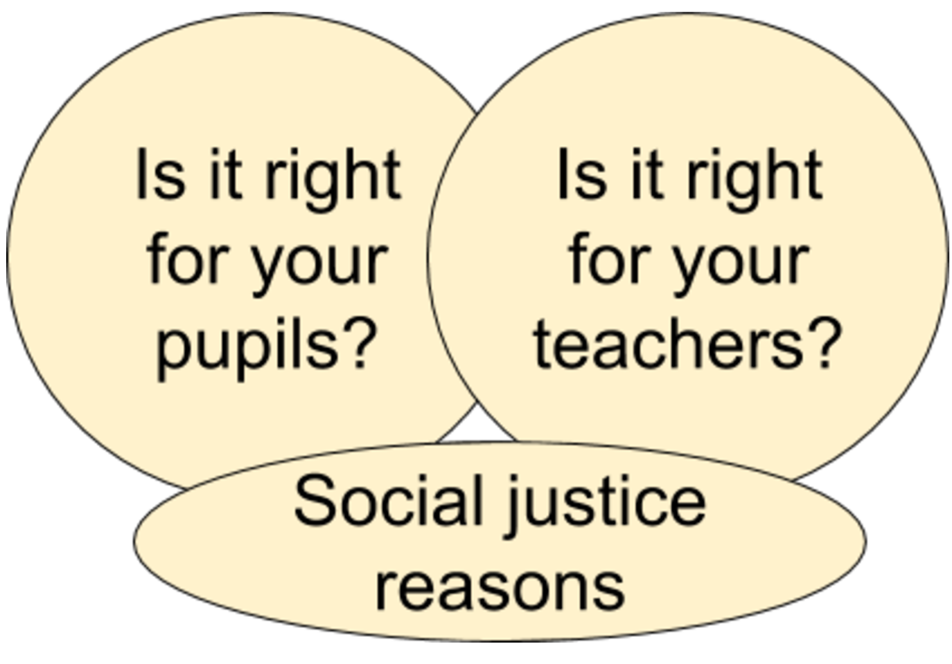

Slide 7
To a large extent, the set a pupil is placed in determines the mathematics he/she will encounter and potentially caps what he/she might attain.
Moving up a set becomes increasingly difficult as pupils progress through the school due to higher sets’ more extensive mathematical knowledge and skills.
Mathematics: made to measure
22 May 2012, OFSTED
Ref: 110159

Slide 8
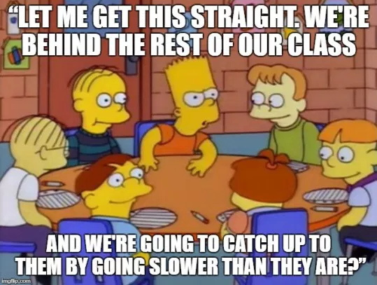
What is differentiation?
What it is
What it isn’t

Slide 9
The Challenge of differentiation
Two principles:
At any point in time, different learners will proceed at different rates
Every minute is valuable

Slide 10
When we present a collection of examples or exercises related to some mathematical idea to our pupils what do we want them to be looking for?
What do we want them to pay attention to?

Slide 11
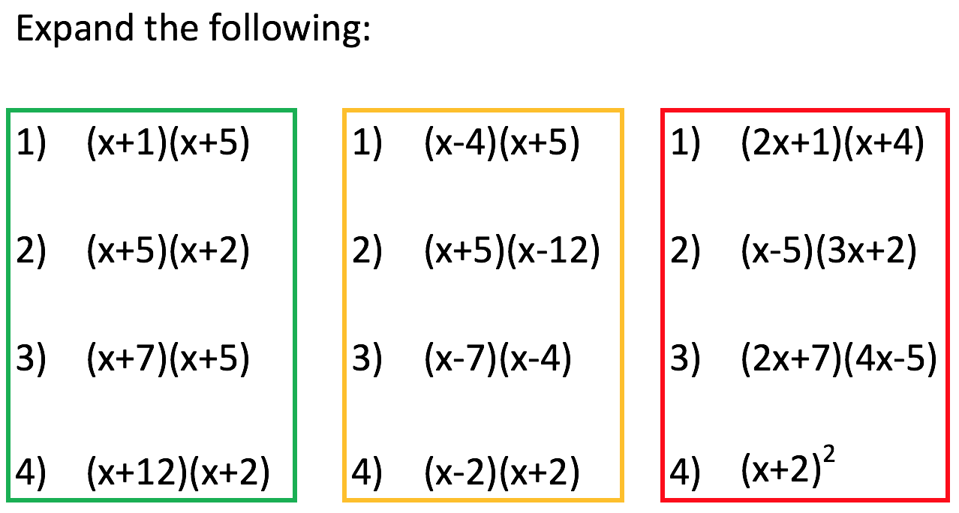
What it isn’t?

Slide 12
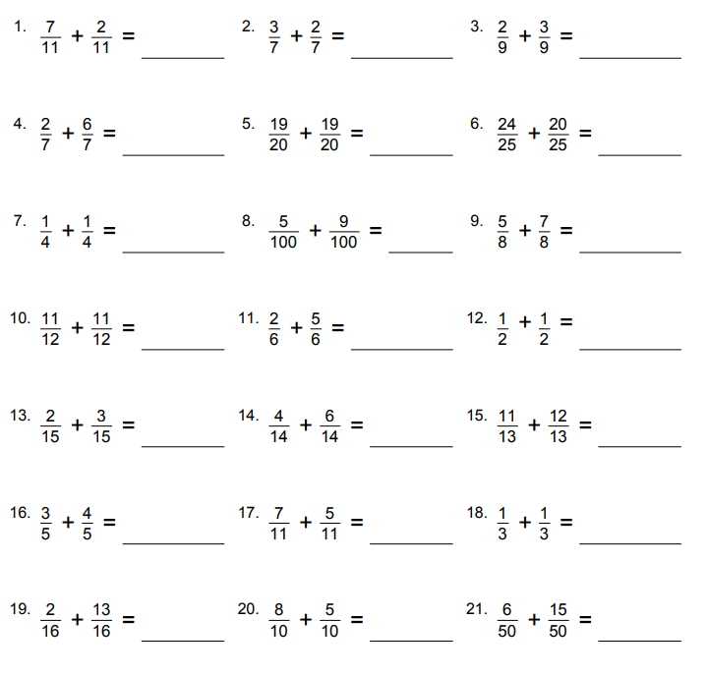
What do we want our students to attend to?
Lesson: Adding fractions with the same denominator.
A quick google search…

Slide 13
Is this an example of differentiation?

Slide 16
Variation
Provides the opportunity
for practice (intelligent rather than mechanical);
to focus on relationships, not just the procedure;
to make connections between problems;
to use one problem to work out the next;
to create other examples of their own.

Slide 17
What do we want our students to attend to?
Lesson: Adding fractions with the same denominator.
Task: Create some questions that use variation

Slide 18
How many ways can you do this?

Slide 19
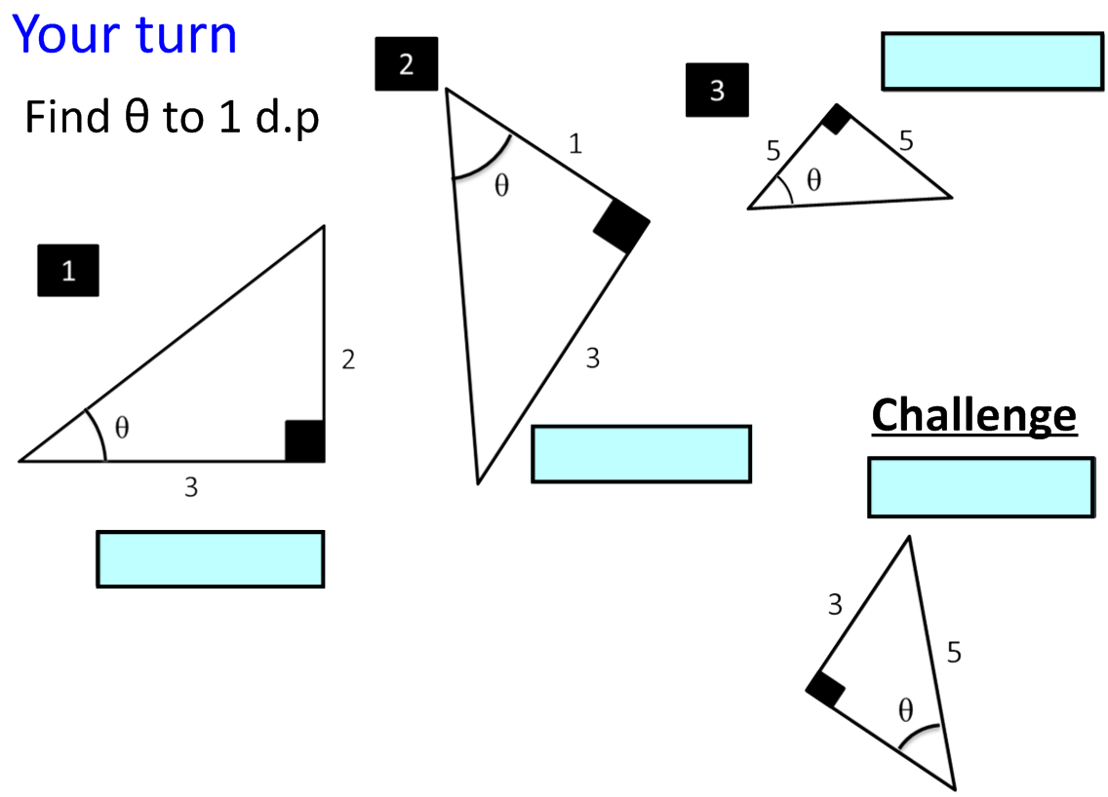
Non- Standard
Standard
Non- Standard
Non- Standard
Finding missing angles using the tan ratio only

Slide 20
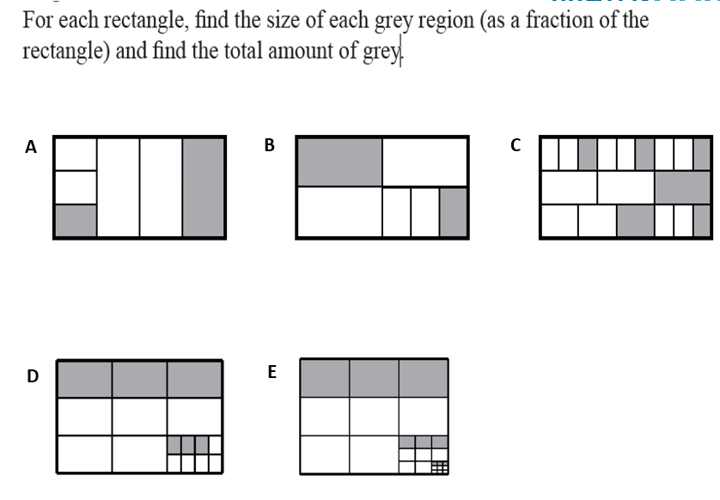
What do you want different students to attend to?

Slide 22
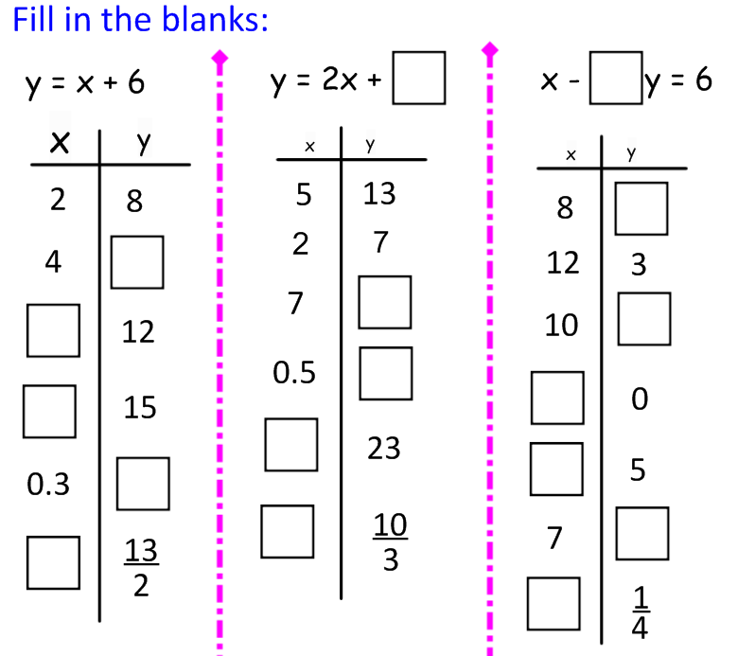

Slide 23
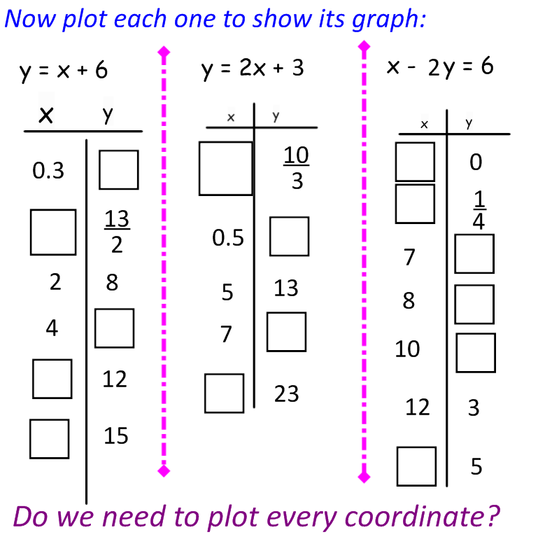

Slide 26
Curious about Secondary
Mathematics Teaching for
Mastery?...
Mastery Open Mornings
Dates: Friday 23rd February 2018
Time: 08:15-12:50
Cost: Free
Beginning Secondary Mathematics Teaching for Mastery?...
Mastery Teacher Research Group Afternoon
Dates: Tuesday 6th March 2018 (A further date will be agreed at these meetings.) Participants are encouraged to attend both dates.
Time: 12:40-15:30
Cost: Free
Doing Secondary Mathematics Teaching for Mastery?...
Mastery Teacher Collaboration Group Twilight
Dates: Tuesday 6th February 2018 (Further dates will be agreed at this meeting.) Participants are encouraged to attend all dates.
Time: 16:30-17:30
Cost: Free
@MathsHubLdnCNW
m.bailey@stmaryleboneschool.com

Slide 27
Curious about Secondary Mathematics Teaching for Mastery?...
Mastery Open Mornings
Dates: Friday 23rd February 2018
Time: 0815-1250
Venue: St. Marylebone School, Main Site.
Cost: Free
This is the perfect opportunity to find out about Mastery teaching for Mathematics and find out more about the other opportunities available to you.
Observe mastery teaching and a Teacher Research Group while learning about the ups and downs of a setting out on a Mastery journey.
There will be a short presentation about the Mastery journey at St. Marylebone School and the impact it has had on teaching and learning in Mathematics. There will also be the opportunity to observe a weekly Teacher Research Group that looks at planning the Year 7 lessons, schemes of work, assessments and best practice. Further to this you will get to observe a Mastery lesson.
Beginning Secondary Mathematics Teaching for Mastery?...
Mastery Teacher Research Group Afternoon
Dates: Tuesday 6th March 2018 (Further dates will be agreed at these meetings.) Participants are encouraged to attend all dates.
Time: 1240-1530
Venue: St. Marylebone School, Blandford Street Site, Teaching School Room.
Cost: Free
If you have seen mastery in action (possibly at one of our open days) and are considering implementing it into your own school, then we invite you to participate in our teacher research group afternoon led by a trained Secondary Mastery Specialist.
Ideally two members of your department will join us at each of the sessions, and other participating schools, to support you in introducing mastery into your teaching and learning. (We understand if this is not possible but it would be the most beneficial).
Participating teachers will receive high quality professional development. This will include the theory behind mastery, tangible pedagogical discussion and support for all to develop and share resources to be used back in their own schools.
The afternoon will provide the opportunity to work closely with other schools also developing teaching for mastery.

Slide 28
Doing Secondary Mathematics Teaching for Mastery?...
Mastery Teacher Collaboration Group Twilight
Dates: Tuesday 6th February 2018 (Further dates will be agreed at this meeting.) Participants are encouraged to attend all dates.
Time: 1630-1730
Venue: St. Marylebone School, Blandford Street Site, Teaching School Room.
Cost: Free
If you/your school are already teaching for Mastery and would like to collaborate with others doing the same then this workgroup is for you. The workgroup will run as a twilight meeting to share good practice (and what hasn’t worked so well) in teaching for Mastery in your own school contexts. The aim will be to have regular meetings to support each other as we continue our Mastery journeys and continually evaluate the work we are doing.
These sessions will at least initially be held at St. Marylebone School where mastery has been embedded into Key Stage 3 over the last 3 years.

