Slide 1
Mixed Attainment Maths
Mark Horley, Megan Bailey, St. Marylebone CE School

Slide 2
51891840

Slide 3
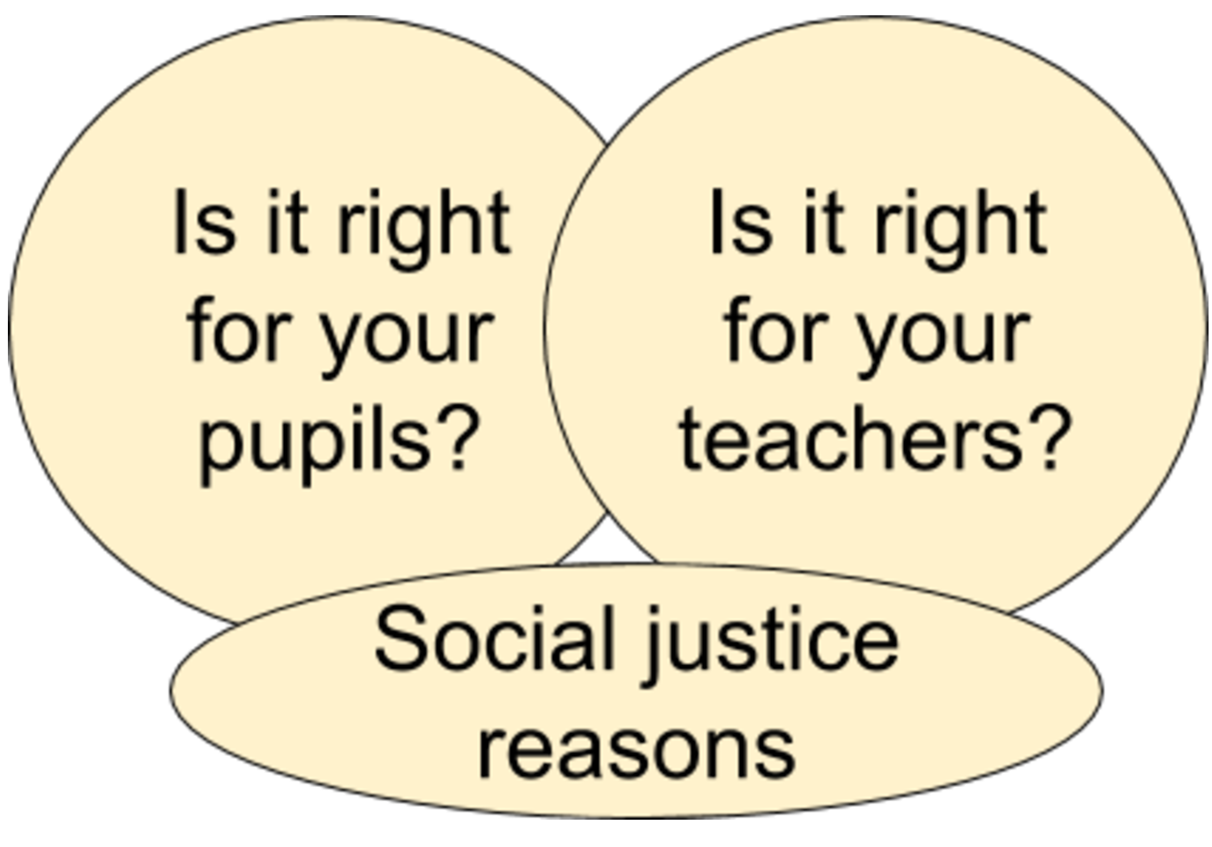

Slide 4
http://www.bristol.ac.uk/media-library/sites/cmpo/documents/taylor2016.pdf

Slide 5
The Challenge of differentiation
Two principles:
At any point in time, different learners will proceed at different rates
Every minute is valuable

Slide 6
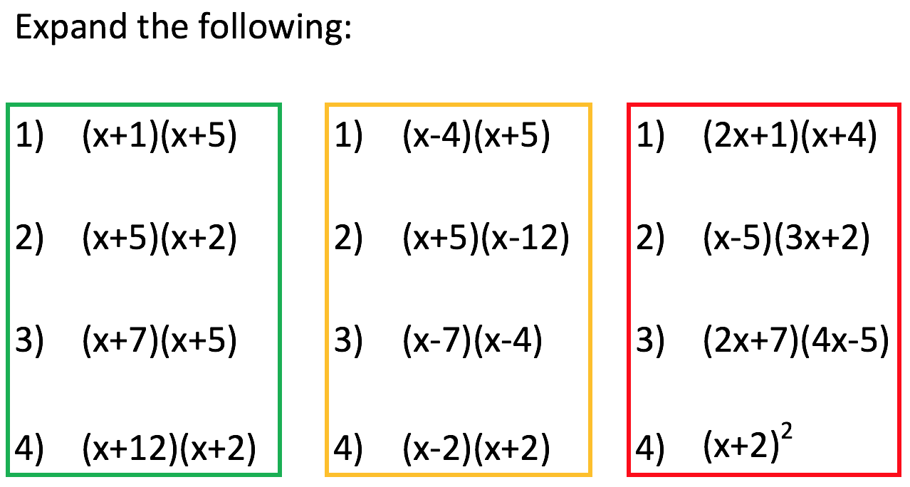

Slide 14
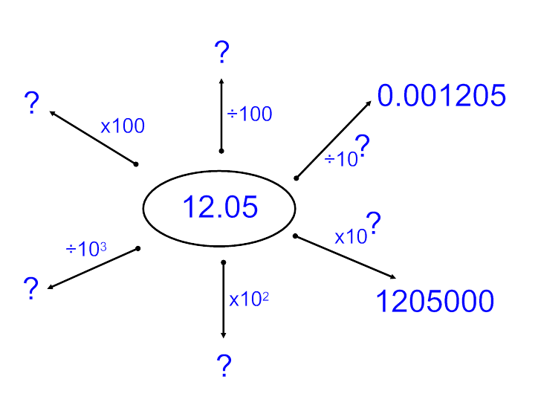

Slide 15
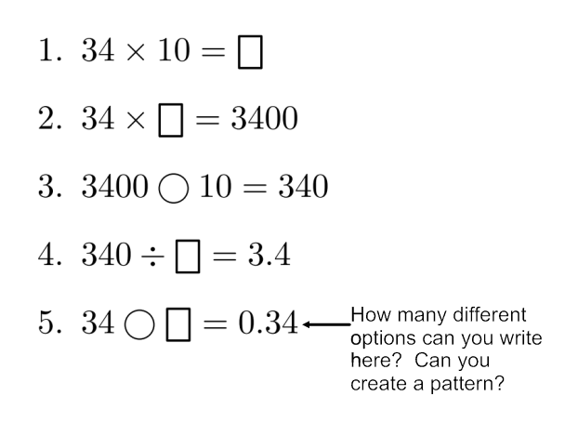

Slide 16
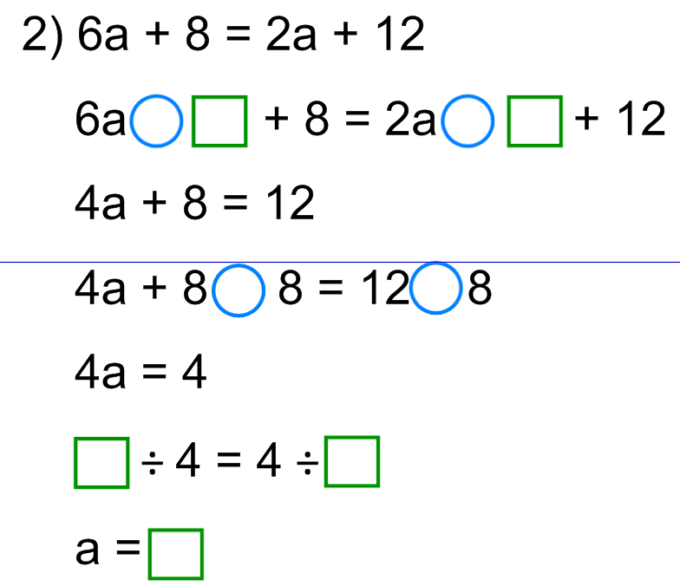

Slide 17
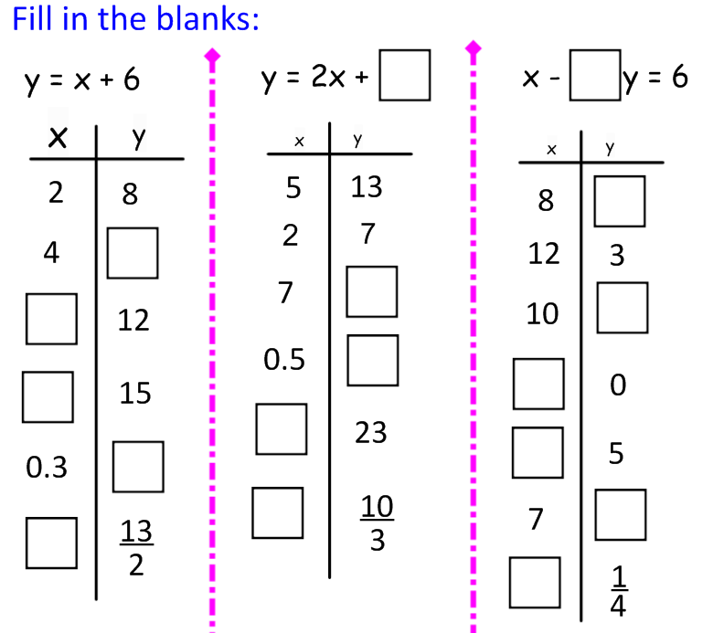

Slide 18
All 4 digit palindrome numbers are divisible by 11

