Slide 1
Ensuring support and challenge for all students in mixed attainment classes Ks2 - Ks4
Helen Hindle
@helenhindle1
www.growthmindsetmaths.com
www.mixedattainmentmaths.com

Slide 2



Slide 3
What are mixed attainment classes?
Classes that have a range of:-
Prior attainment,
SEN,
Pupil Premium
Attitude to Learning
EAL

Slide 4
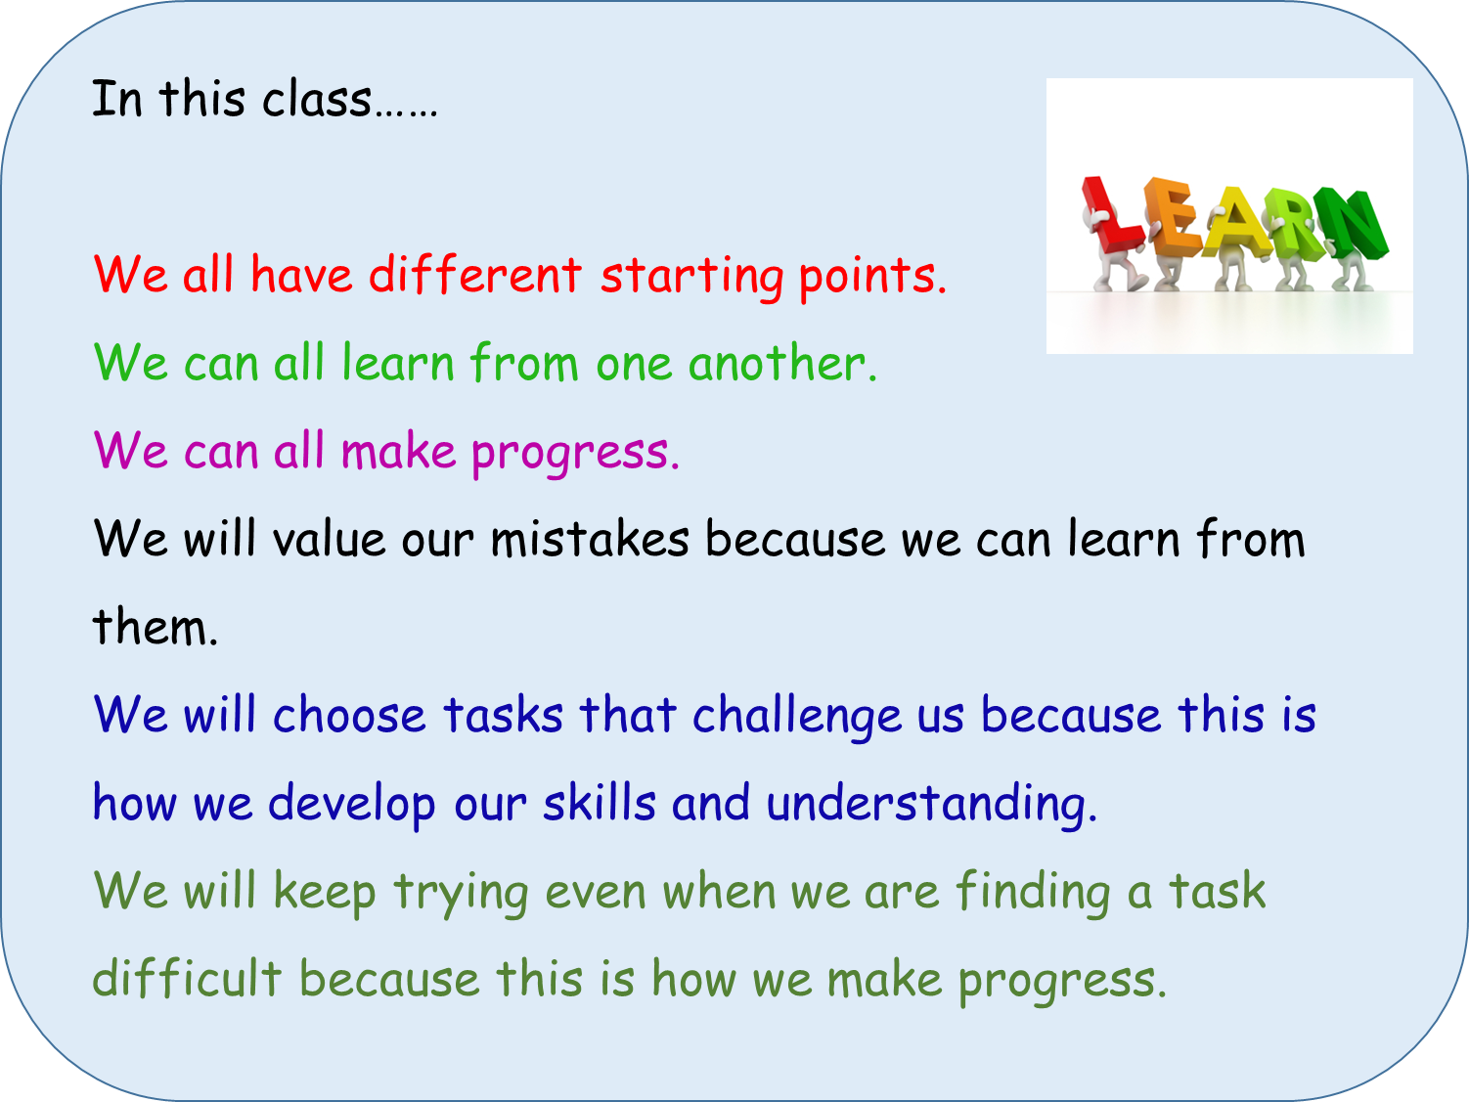
Changing the culture of the classroom…..
Notes:
This is a sticker that goes on the front of our pupils’ exercise books.

Slide 5
Year 9 - Sequences | a) I can draw the next two patterns in a sequence. HM 196 b) I can find the next two terms in a sequence. HM 197 | c) I can find a term to term rule for a linear sequence. (Describe a sequence in words.) HM 197 d) I can generate terms of a sequence from a term to term rule. HM 197 e) I recognise and I can use sequences of triangular, square and cube numbers, simple arithmetic progressions, and other sequences. HM 261, 262, 263 | f) I can find a position to term rule for a linear sequence and explain how I worked it out. HM 198 g) I can generate terms of a linear sequence from a position-to-term rule and decide whether a number is a term in a sequence. HM 198 h) I understand the difference between a linear sequence and a quadratic sequence. HM 247 | I) I can find the next two terms of a quadratic sequence. HM 249 & 250 j) I can generate terms of a quadratic sequence from a position to term rule and decide whether a number is a term in a sequence. HM 249 & 250 | k) I can find a position to term rule for a quadratic sequence. HM 248 l) I recognise and can use simple geometric progressions (r^{n} where n is an integer, and r is a rational number > 0 or a surd). HM 264
Notes:
Print slides 1-4, four to a page.

Slide 6
Discuss
Do you use anything similar?
How do you differentiate?

Slide 7
Differentiation is essential to the meet the diverse needs of all the learners in the class.
Differentiation involves a range of techniques, strategies and organisational options.

Slide 8
Differentiation by ………
Task - Pupils work on different tasks / worksheets with the lesson.
Support - Some pupils may work with a teaching assistant
Questioning - Bringing all students in a class into a question and answer exchange.. adjusting the level of questioning to the student in a subtle way.
Explanation - Pupils receive different teacher input at different times throughout the lesson.
Outcome - The same stimulus leads to open ended responses. (‘Multiple Entry Point Tasks’ )
Expectation - There are various learning goals that are shared with pupils. Pupils are taught how to and encouraged to self select the appropriate learning goal, for example through reference to a learning journey.

Slide 9
Open Starters / Do Now
Lead to a class discussion
Explanations come from the pupils
Link to the main activity / task.

Slide 10
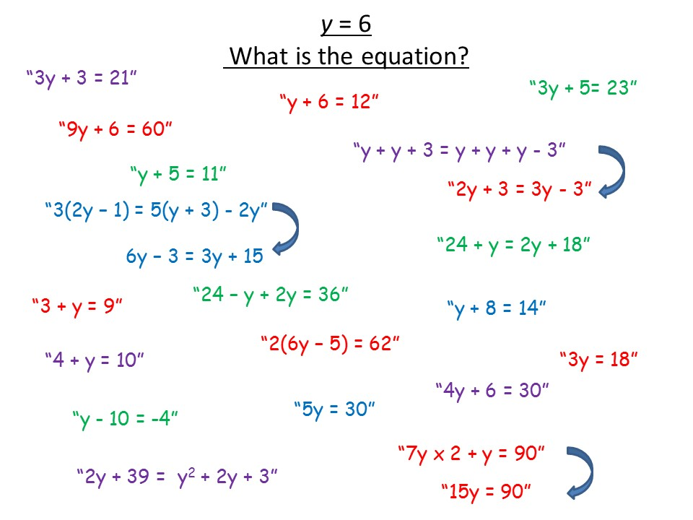
Notes:
Example of an open starter activity, with pupils’ responses.

Slide 11
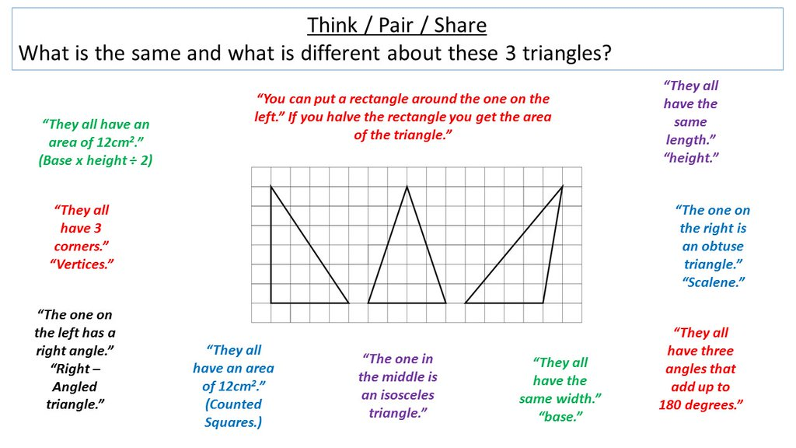
Notes:
Example of an open starter activity, with pupils’ responses.

Slide 12
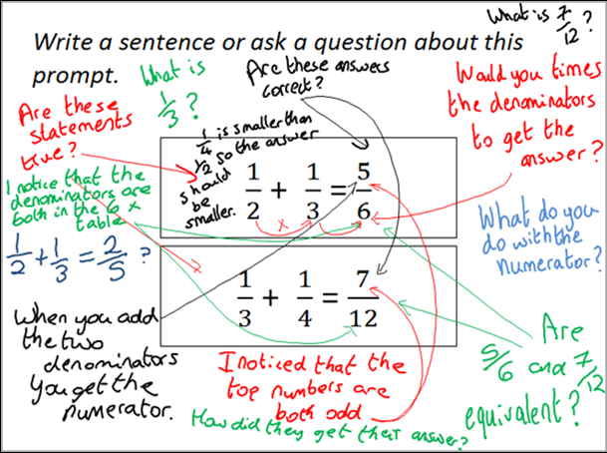
Notes:
Example of an Inquiry Prompt, with pupils’ responses. See www.inquirymaths.org

Slide 13
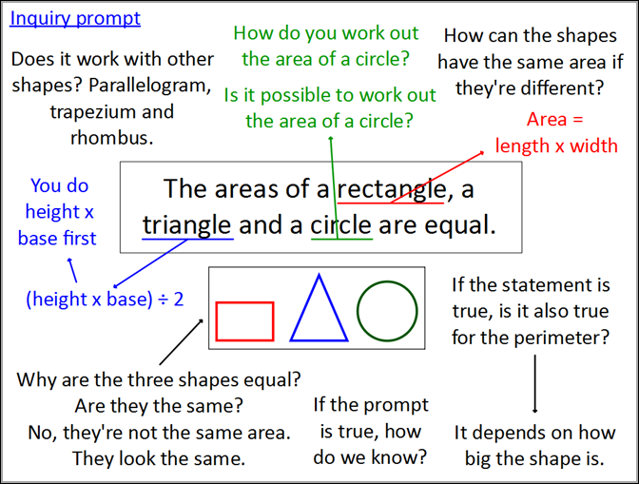
Notes:
Example of an Inquiry Prompt, with pupils’ responses. See www.inquirymaths.org

Slide 14
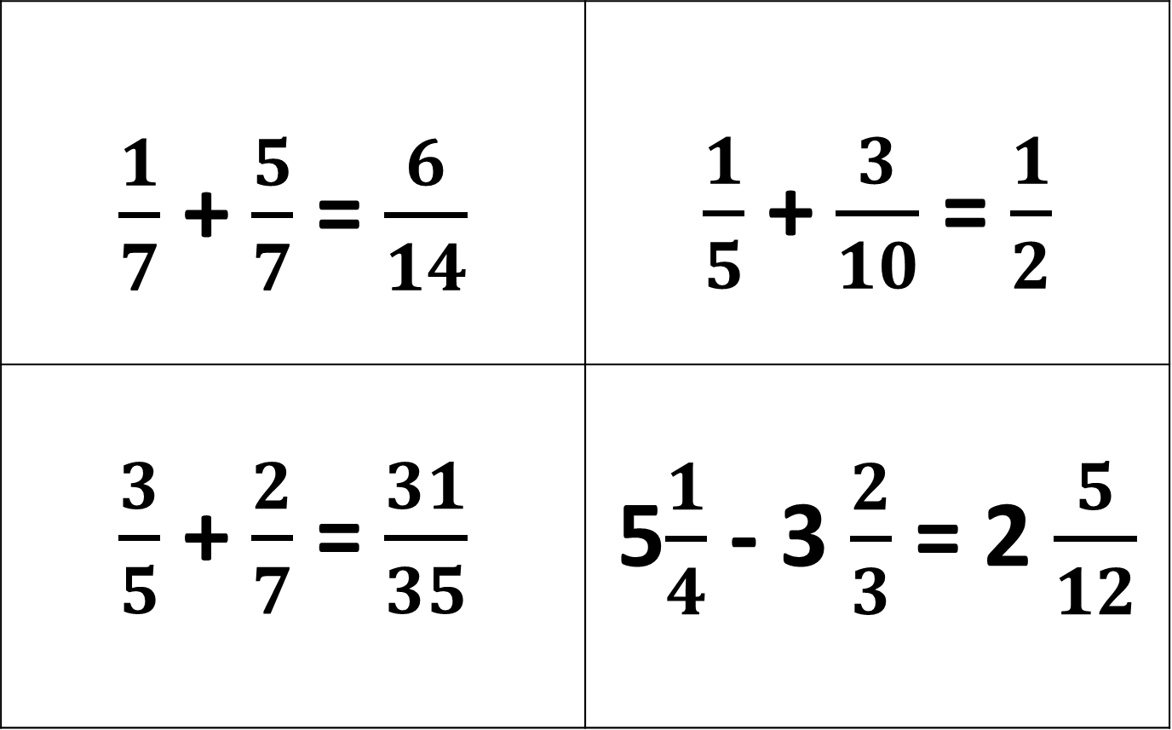
True or False? – Convince Me
$\frac{1}{7}$ + $\frac{5}{7}$ = $\frac{6}{14}$ | $\frac{1}{5}$ + $\frac{3}{10}$ = $\frac{1}{2}$
$\frac{3}{5}$ + $\frac{2}{7}$ = $\frac{31}{35}$ | 5$\frac{1}{4}$ - 3 $\frac{2}{3}$ = 2 $\frac{5}{12}$
Notes:
Example of an open starter activity.

Slide 15
Which is the odd one out?
You must give a reason for your answer.
6
3
2
4
6
3
2
2
14
Notes:
Example of an open starter activity

Slide 16
Which are familiar?
Which do you find effective?
How could you change these for a different topic?

Slide 17
Ask a question – make a comment starter activities.
What questions might pupils ask?
What conjectures might they make?
What explanations might they offer?
What misconceptions might they reveal?
Notes:
10 minutes

Slide 18
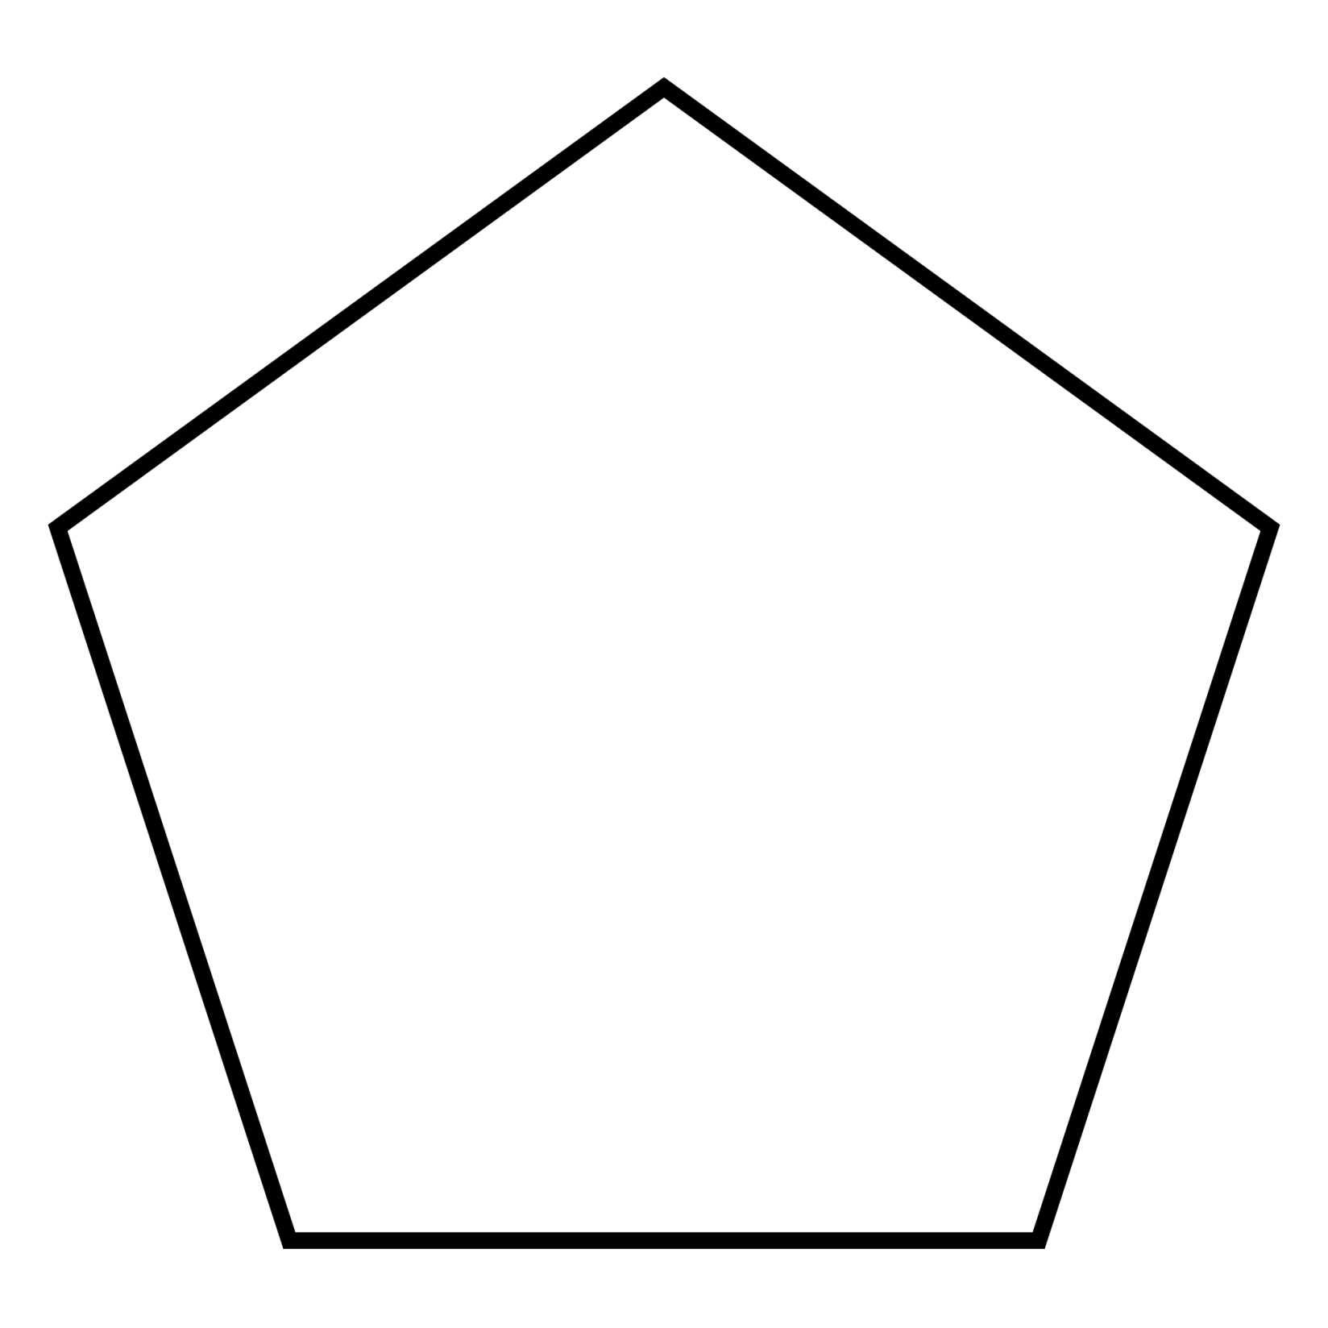
Make a comment or ask a question.

Slide 19

Make a comment or ask a question.

Slide 20

This is a regular pentagon, find the value of the missing angle.

Slide 21
A square is constructed using vertices of a regular dodecagon as shown. What fraction of the dodecagon is shaded?

Slide 22
Differentiated Tasks Discussion
Which is the most Effective?
Which has the greatest depth of Maths?
Which is the most Open?
What further adaptions might you make?
What concrete resources might you use?

Slide 23
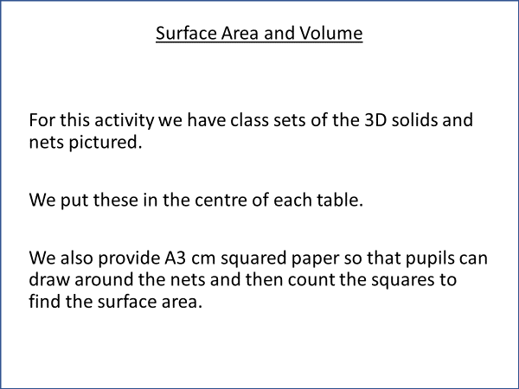
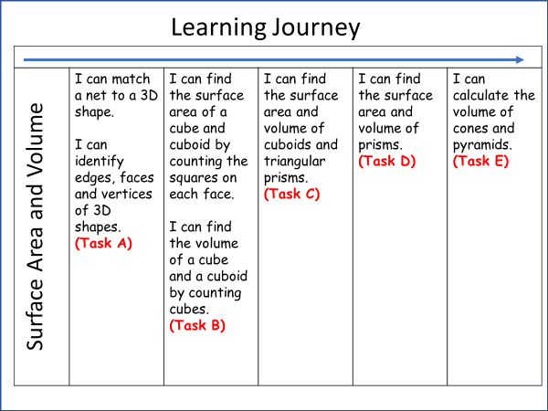
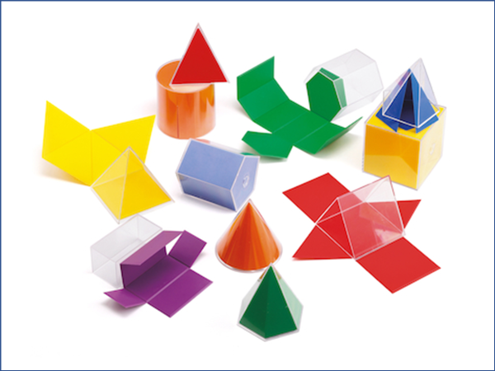
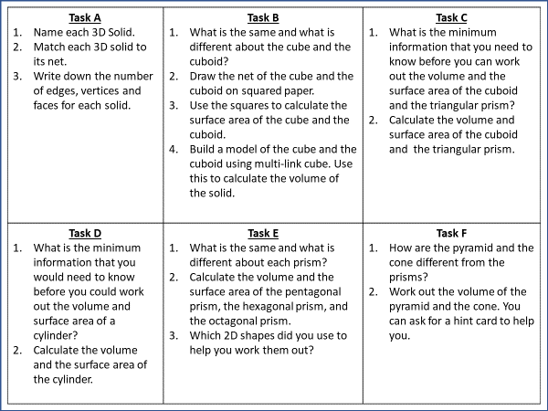
Notes:
Example of a differentiated main activity.

Slide 24
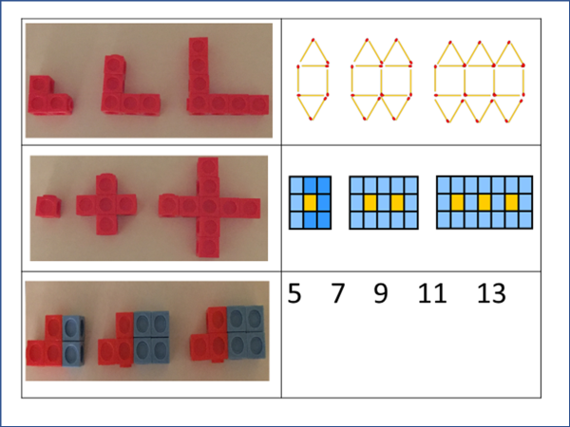
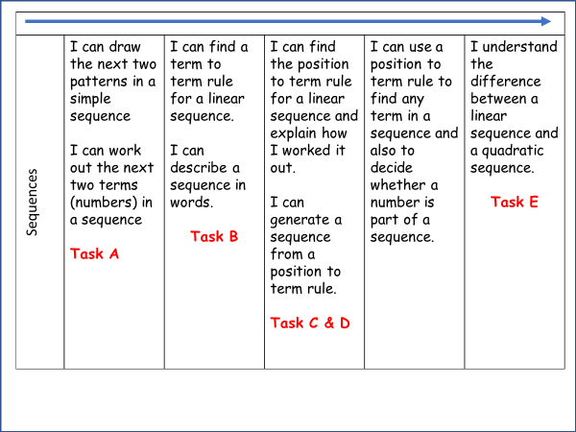
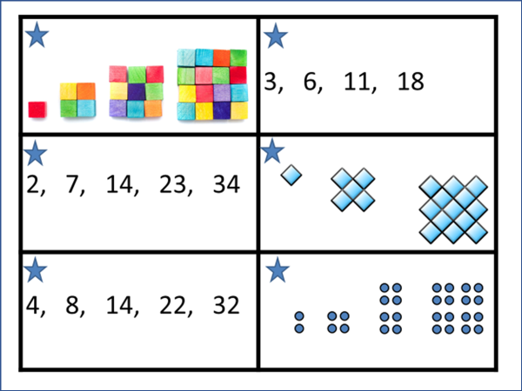
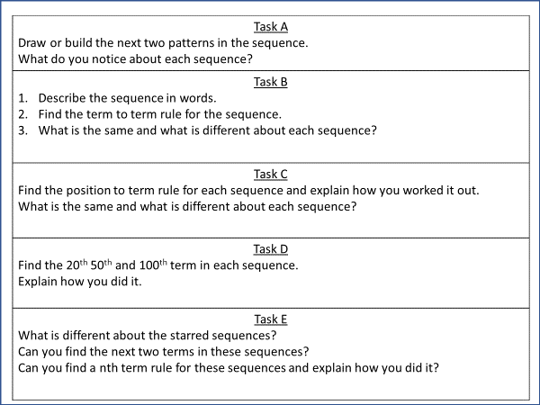
Notes:
Example of a differentiated main activity.

Slide 25
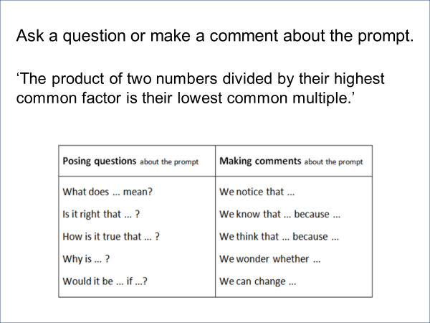
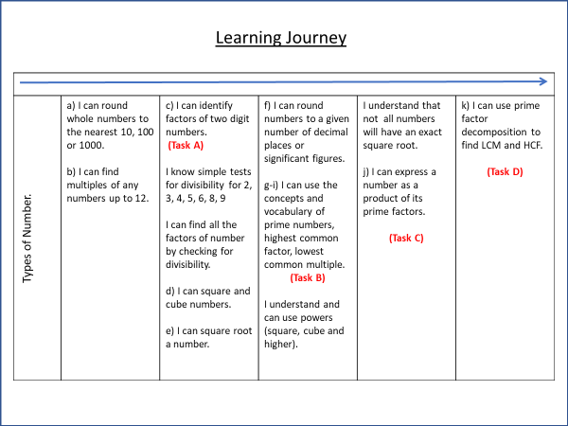
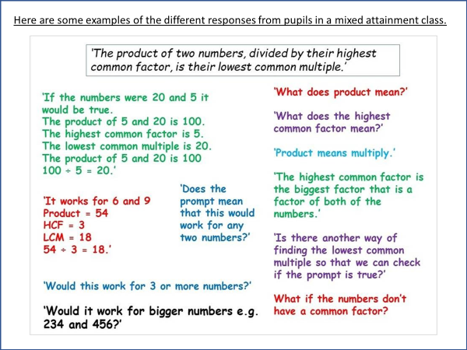
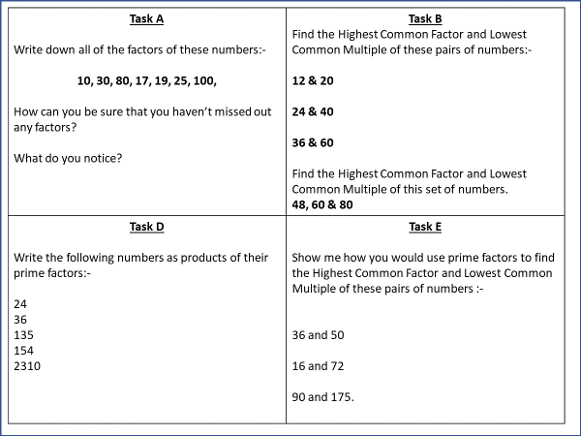
Notes:
Example of a differentiated main activity.

Slide 26
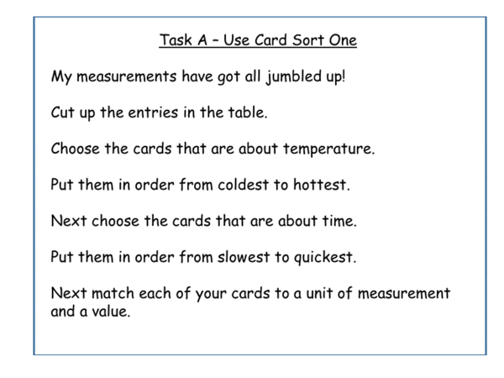
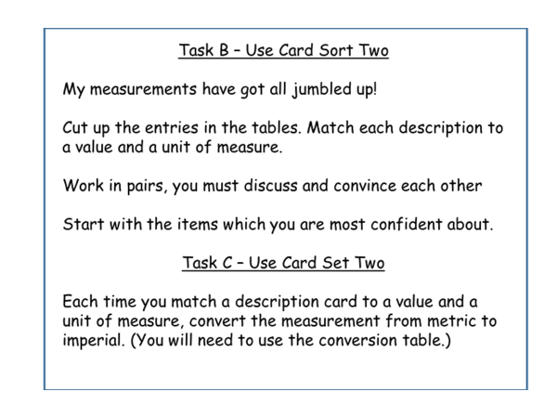
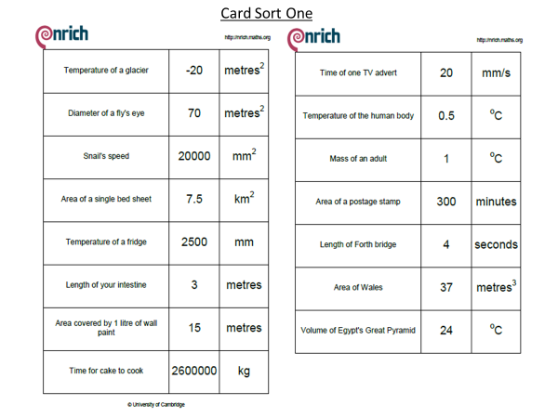
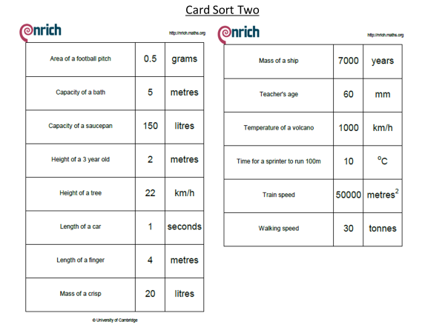
Notes:
Example of a differentiated main activity.

Slide 27
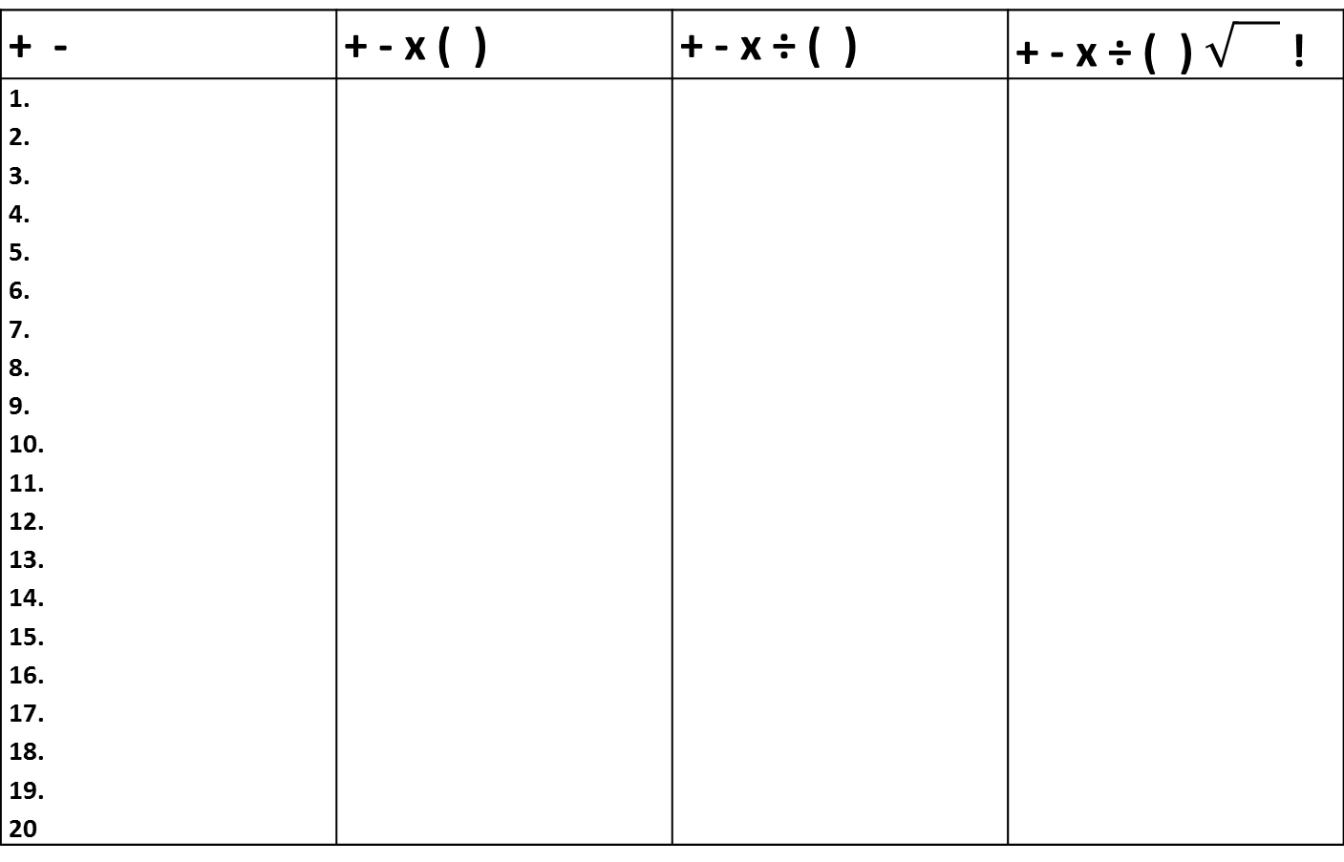
B
I
D M
A S
Four 4s investigation
Use the symbols at the top of each column to make the
numbers up to 20 with four 4s.
Example: 4 + 4 + 4 – 4 = 8
+ - | + - x ( ) | + - x ÷ ( ) | + - x ÷ ( ) !
1. 2. 3. 4. 5. 6. 7. 8. 9. 10. 11. 12. 13. 14. 15. 16. 17. 18. 19. 20
Notes:
Example of a differentiated main activity.

Slide 28
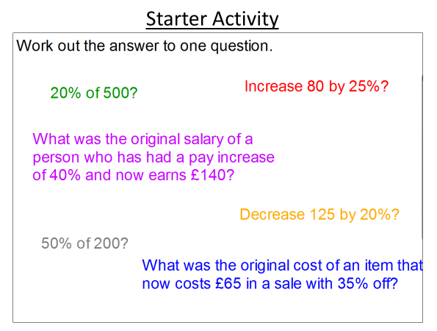
Main Activity –
The answer is…….
Make up six questions that have the same answer.
Put your questions in order from the least to the most challenging.
Notes:
Example of a differentiated main activity.

Slide 29
Create an equivalent expressions spider diagram
Use substitution to check that your expressions are equivalent.
Task A Using the symbols for addition and subtraction write as many different expressions as you can for your chosen expression. | Task B Using the symbols for addition, subtraction, multiplication and division write as many different expressions as you can for your chosen expression. | Task C Using the symbols for addition, subtraction, multiplication and division and using brackets and indices write as many different expressions as you can for your chosen expression.
15n + 9
36n - 30
6n² + 9
Notes:
Example of a differentiated main activity.

Slide 30
All pupils must have access to the full range of differentiated tasks
Pupils must be given the opportunity to select the appropriate task for themselves (the teacher should re-direct when necessary.)
Pupils should be aware that every lesson they should be engaged in a task which challenges them but which is also achievable
Pupils should be given frequent opportunities to reflect on their learning / progress against their learning journey.

Slide 31
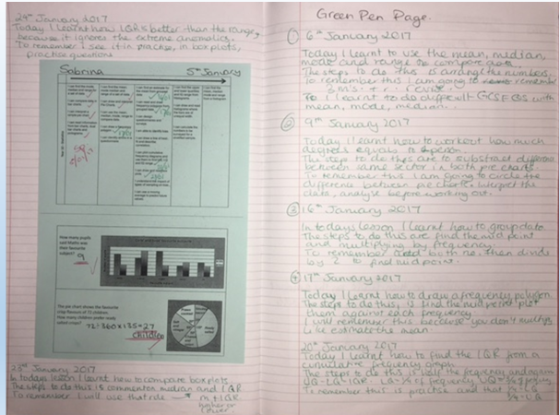
Student Reflection
Notes:
Example of a strategy for student reflection.

Slide 32
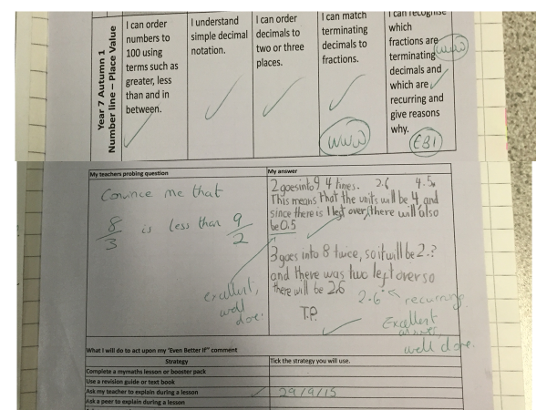
Notes:
Setting a challenge question after marking an assessment.

Slide 33
GREEN PEN PAGE
Today I learned…
The steps to do this are…
To remember this I will… or I need to remember to….
Notes:
Example of a strategy for student reflection.

Slide 34
Notes To Myself – Directed Number
Name:
Adding positives | Adding negatives | Subtracting positives
Subtracting negatives | Multiplying negatives | Dividing negatives
Notes:
From Gareth Evans @MrE_Maths . Gareth has an excellent website garethevansmaths.wordpress.com

Slide 35
Notes:
From Gareth Evans @MrE_Maths . Gareth has an excellent website garethevansmaths.wordpress.com

Slide 36
Notes:
From Gareth Evans @MrE_Maths . Gareth has an excellent website garethevansmaths.wordpress.com

Slide 37
Colour in the arrow, up to the statement which best describes your current understanding.
 | I’m so confident - I could explain this to someone else!
 | I can get to the right answer but I don’t understand well enough to explain it yet.
 | I understand some of this but I don’t understand all of it yet.
 | I tried hard and I listened but I am finding this challenging. I will make sure that I get help with this next lesson.
 | I do not understand any of this yet. There are things I could do to be a better learner next lesson.
Notes:
Example of a strategy for student reflection.

Slide 38
My Favourite MISTAKES
Means
I
Start
To
Acquire
Knowledge
Experience
Skills
A mistake that moved my learning on……
Notes:
Example of a strategy for student reflection.

Slide 39
Tips I would give a friend to solve this problem are ......... | I have made a link between this topic and … | To help me move forward, when I got stuck today, I ….
Today I interacted with the teacher by …… | Today I am still unsure about ……………… To fill in this gap I intend to ………… | A barrier to my learning today was……….. I will try to overcome this by …..
Today I explained to ………. how to ………….. | Something I have learnt today about the way I learn is ……… | At home, I need to look at ………………
Notes:
Example of a strategy for student reflection.

Slide 40
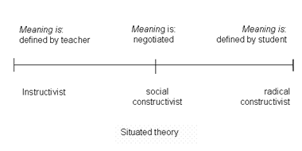
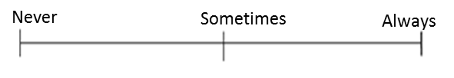
Which mindset did I demonstrate? | Mark each scale with an arrow.
Did I use whole class discussions / explanations as learning opportunities? (Did I listen? Did I ask questions? Did I contribute answers or make suggestions?)
Did I work on tasks that challenged me?
Did I use strategies to ‘un-stick’ myself when I found the tasks difficult?
Did I check my work for mistakes and correct them?
Did I put as much effort as I possibly could into the tasks?
Never
Sometimes
Always
Notes:
Example of a strategy for student reflection.

Slide 41
Progress Pyramid
One question I would like answered…
Two things I am not sure about yet….
Three things I understand well enough to explain to someone else…
Notes:
Example of a strategy for student reflection.

Slide 42
I am really pleased with...
Today I have tried to...
To progress I need to...
Today I have learned that...
In these questions I have learnt that…
I have been able to…
But I got stuck on...
Self Reflection
Before this lesson I could already...
Now I can also...
One thing I need to remember from today’s lesson is...
I was successful when I…
I did not know how to…
But now I can…
The most important thing I learned today is...
I can see the link between...
Notes:
Example of a strategy for student reflection.

Slide 43
Set high expectations and encourage
Challenge
Collaboration
Choice

