Slide 1
Developing GCSE Questions WJEC
Similarity
2011 to 2013

Slide 2
 | D | C | B | A | A*
Similarity |  | Work out unknown sides of shapes using scale factors and ratios Know why two shapes are similar | Know the conditions to show that two triangles are congruent Set up equations to find missing sides in similar triangles | Solve practical problems using similar triangles Solve problems using area and volume scale factors | Solve related problems involving, for example, capacity, using area and volume scale factors
Notes:
You might use this LJ from a previous lesson already glued into their books. If this is the case try to get pupils to annotate their LJ with dates and using a different coloured pen.

Slide 3
Teacher Page
Part 1 – trying the exam question
They can have a go at the question in any way they want and they can use a calculator.
When they have had a go get them to explain their methods.
Ask them about the advantages and disadvantages for each method.
Part 2 – Making up some questions
There are many other questions an examiner might ask. Ask learners to suggest some of these and write them in their books or on the sheet if you have one. In doing this, they should not change the diagrams in any way, but simply ask new questions about the existing diagrams.
Part 3 – try the made up quesitons
Ask learners to choose one of these questions that they think they can answer and encourage them to work on it in pairs. Learners may like to compare their different ideas by writing them on the board.
Part 4 – Developing this further
Using one of the template questions learners should then work in pairs or threes and write new questions together with solutions (on the back of the sheet). Encourage learners to ask questions that they consider challenging but that are within their capabilities. The new questions should be passed around the groups to be answered by other learners. Where learners have difficulties in answering questions, the question writers should explain what they intended and act as a teacher, helping each other to answer the questions. Alternatively, some of the new questions may be photocopied for future sessions or for homework

Slide 4
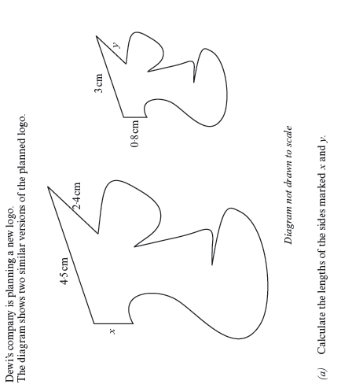
Write down some other questions that may be asked about this situation.
GCSE question on Similarity
Notes:
Calculator Questions – higher

Slide 5
Template for similarity GCSE Questions
Find the missing side...................... On shape.................
Find the missing side...................... On shape.................

Slide 6
Template for similarity GCSE Questions
Find the missing side...................... On shape.................
Find the missing side...................... On shape.................

Slide 7
Template for similarity GCSE Questions
Find the missing side...................... On shape.................
Find the missing side...................... On shape.................

Slide 8
Template for similarity GCSE Questions
Find the missing side...................... On shape.................
Find the missing side...................... On shape.................

Slide 9
Notes:
Extension question

