Slide 1
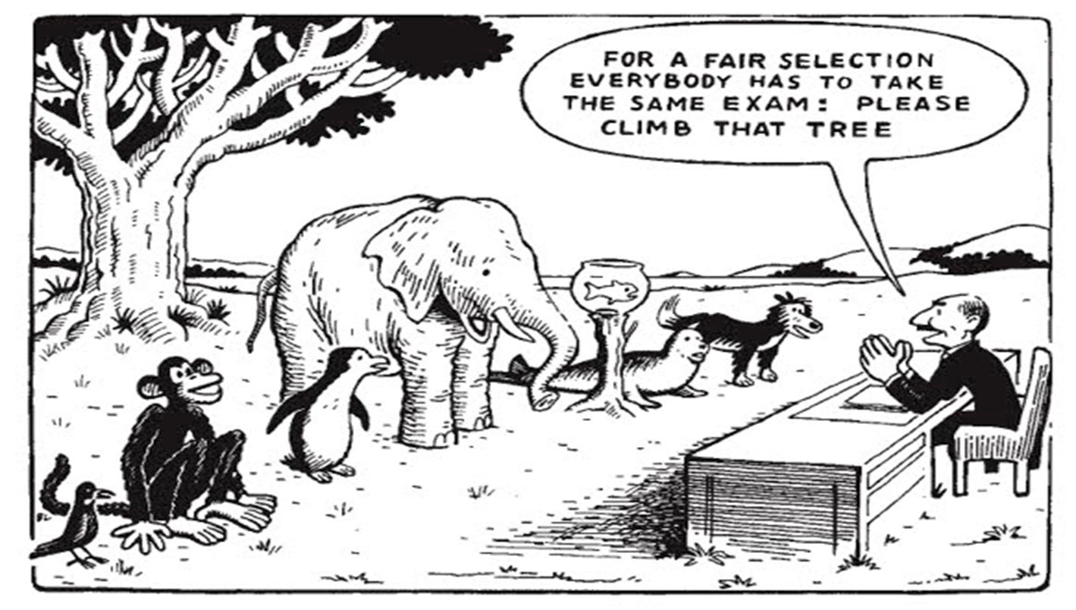
Zebedee Friedman
@zebfriedman
@springmaths
zebfriedman@springmaths.org
www.springmaths.org

Slide 2
Mixed Ability Groups
Mixed Attainment Groups

Slide 3
0 – set 1 to set x strictly based on test results
5 – some mixing e.g. in tiers
10 – totally mixed classes (across tiers)

Slide 4
Year 10 &11 classes
Post 16 re-sit students
Mixed attainment groups for exam classes

Slide 5
Learning Journeys
GCSE Mysteries
Ipads and actors!

Slide 6
Learning Journeys

Slide 7
GCSE Questions
WJEC
Angles
2011 to 2013

Slide 8
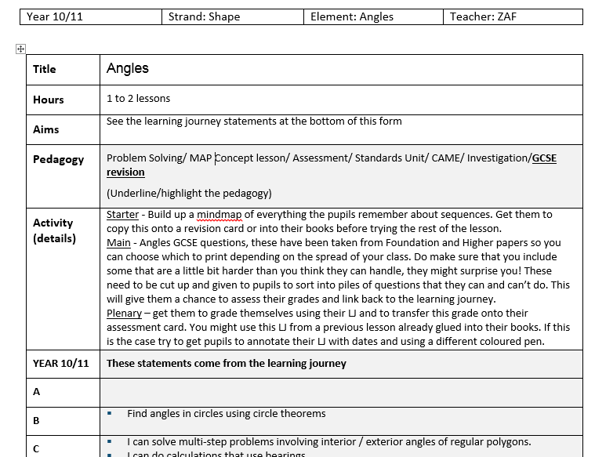

Slide 9
Teacher notes
The notes for each slide will say which exam papers the questions come from
You can get pupils to sort the cards in various ways:
  RAG
  Can do and can’t do
  Question types
  Line from easy to hard
Think about which questions you would like pupils to try after they have sorted them
Would you like them to help each other?
You might want to link this to the learning journey:
  Get pupils to decide which grade each question is
  Pupils to self assess themselves after doing some questions and looking at the Learning journey

Slide 10
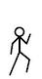
 | G | F | E | D | C | B
Angles | I can distinguish between acute, obtuse, reflex and right angles. | I can work out the size of missing angles at a point I can work out the size of missing angles on a straight line I can draw and measure angles | I know the sum of the interior angles of a triangle and a quadrilateral. I can calculate missing angles in triangles and quadrilaterals I can use bearings | I can find alternate/corresponding angles, given two parallel lines. I can calculate the sum of the interior angles of polygons. I can calculate the size of an interior angle of a regular polygon. Given the exterior angle of a regular polygon I can calculate the number of sides. I can draw bearings | I can solve multi-step problems involving interior / exterior angles of regular polygons. I can do calculations that use bearings | Find angles in circles using circle theorems
Notes:
You might use this LJ from a previous lesson already glued into their books. If this is the case try to get pupils to annotate their LJ with dates and using a different coloured pen.

Slide 11
Cut the questions up and put into envelopes
Instructions for pupils
Sort your questions into similar types
Now into 'can do' and 'can't do' piles
Try as many as possible
Make a note of the questions you want explained

Slide 12
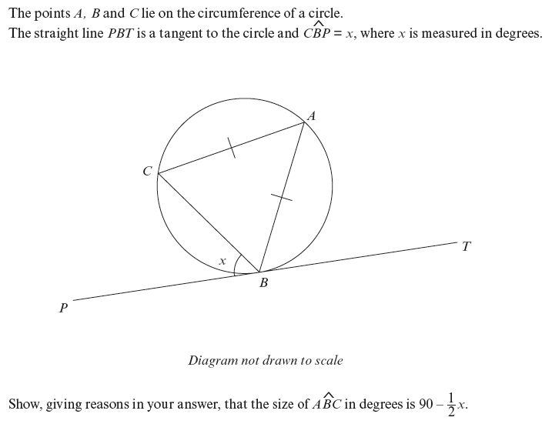
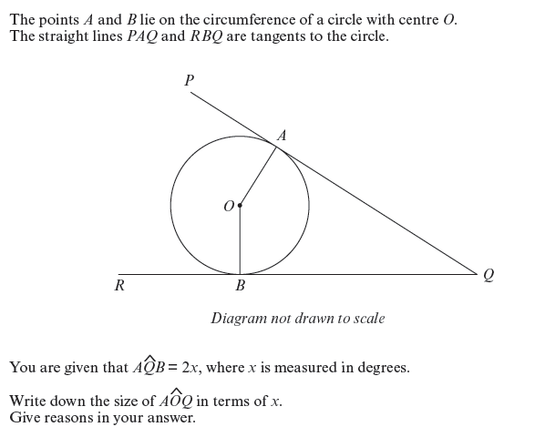
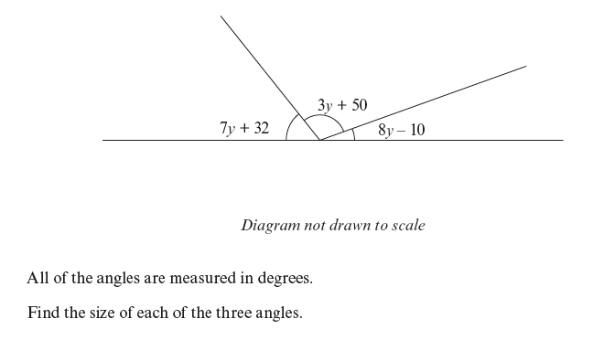
Notes:
Non Calculator Questions - Higher

Slide 13
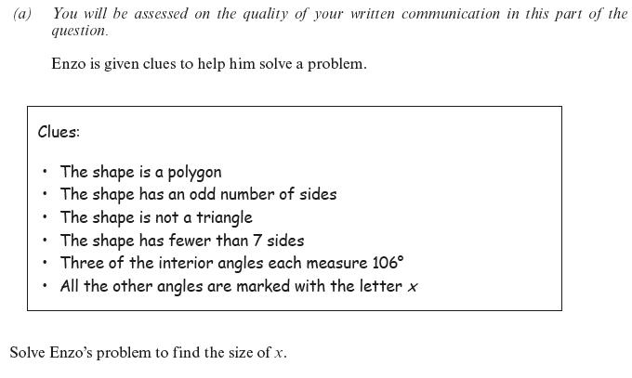
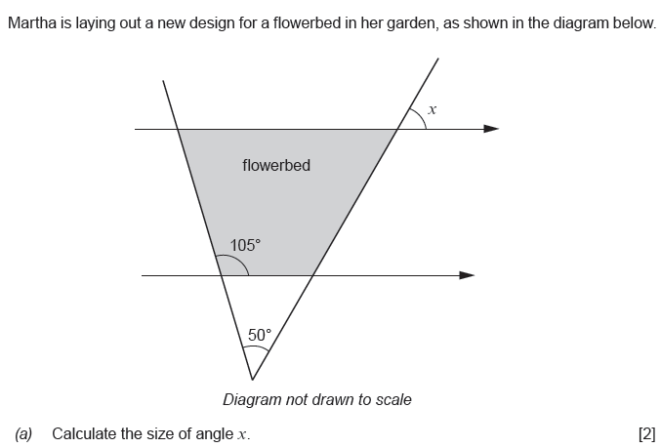
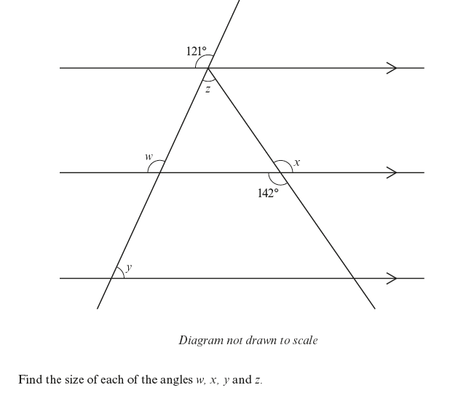
Notes:
Non Calculator Questions - Higher

Slide 14
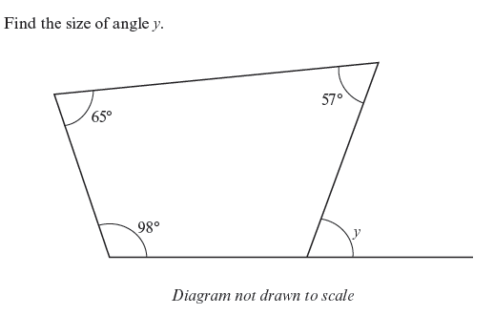
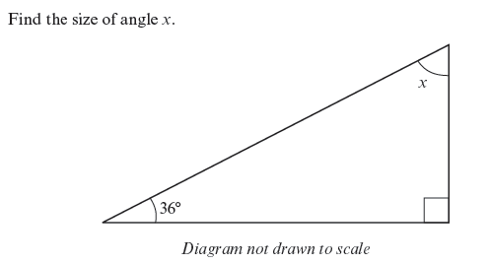
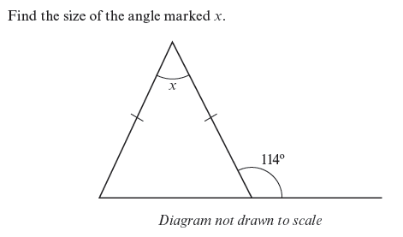
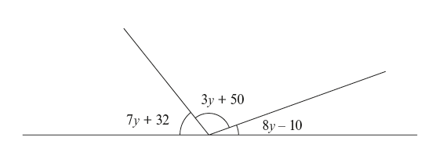

Notes:
Non Calculator - foundation

Slide 15
Area, Perimeter and Volume
Year 11 class
Foundation and Higher

Slide 16
Notes:
D to A grade

Slide 17
Notes:
DC grade

Slide 18
Probability
Year 10 class
Foundation and Higher

Slide 19
Notes:
Grade F to A named students – my assessment

Slide 20
GCSE Mysteries

Slide 21
Ipads and Actors

Slide 22
Feedback from
Learners
And
Teachers

Slide 23
Really liked being in a mixed group, I thought they'd pull out the stupid people and the clever people but we're all treated the same. Never felt stupid in there.

Slide 24
We had no sets. When we had sets I felt like other people were better than me in class because better people had more attention.

Slide 25
Working with people in the B42s helped because we had higher and foundation, we showed each other each other's questions. It surprised me that we were not split into groups by ability. Normally we have sets with lower in one class and higher in another. Mixed sets made the biggest difference to me all year

Slide 26
I didn't think I could do maths then I realised that anyone can do maths, so if I practiced I could get better. I realised that anyone could do maths because I heard stories about people going from D to B so I thought I could too.

Slide 27
In year 7,8,9 I was confused most of the time in maths. Teaching other people helped me, algebra is my strongest point, so teaching it to other people meant I improved even more. I used to feel like poo before ( last year), I feel more confident now and I enjoy maths. When I saw work I didn't understand that was a higher grade, I was intrigued. And I found it interesting.

Slide 28
Last year I didn't do maths at all. I went down to set two because I just wasn't very good. I felt crap anyway and moving down a set made me feel even more crap. November... When they sets stopped I wasn't sure about it but by the time November came I felt it was working and I felt better. People could teach each other things they didn't know. We used to do learning journey assessments. When I saw work I didn't understand I felt like I would get it one day with my friends help. I wasn't uncomfortable.

Slide 29
Set 3 last year, looking back I feel I achieved more being in mixed groups, last year people sometimes misbehaved because they didn't get it. I had more help off friends of different abilities.

Slide 30
Last year I felt bad about maths I felt I'd failed. I was in set 1, I liked maths but we had supply for a while and he was teaching us about algebra and I had no idea what he was doing. I liked being in set one. I'd been in that set since year 8. I didn't think I'd like mixed groups but I did. The pace we went at, everyone could learn. Every now and then we did tests and LJ assessment so I knew my grades. I liked the assessment cards so I knew where I was. Someone with a different ability could help me and I could teach them. Some topics I was better at and other people were better than me at others so we helped each other out. At first I thought it would be too simple but it wasn't. I was pushed hard enough.

Slide 31
Mixing groups was fine instead of sets, when you go through school people ask you what set your in, if you say set 3 people will say your stupid and different from other people. For example in set 5 you colour in. Mixed groups are better because you mix with people who are good at maths and not good at maths so they can learn off each other.

Slide 32
Last year I felt rubbish about doing maths. I didn't look forward to it at all. I knew I'd get the lowest score in the class. Set 2. There were brainier people in that class. Mixed classes in year 11 was better because I was with my friends. Sometimes my friend would have to show me how to work things out. You weren't judged on your ability because you could get Cs.

Slide 33
We helped each other. I didn't mind doing 8 hours a week. It made me like it a lot more because I understood it. I really liked being in HF (mixed) groups, I felt like I was a teacher sometimes and I was shocked to see how many foundation people could do higher questions I saw their confidence grow. I really believe 'to teach is to learn twice', it helped to stick it into my mind.

Slide 34
Last year, set 1, I liked my teacher and being with my friends. I didn't like how some people would race ahead and I didn't know what was going on. This year I liked the mixed groups because I was with different friends. It was easier to get on with the work, in the other class people who raced ahead but couldn't explain how they did it. In mixed groups I could help people and I was doing higher, but they could help me too even if they were doing foundation. I didn't feel I was held back In My work.

Slide 35
Last year, set 1, the class was taught to the middle. I like the mixed groups because there is always more I can do. I can teach my friends and they can teach me. It works!

