Slide 1
Mixed attainment at ks4
Abdulkadir Mohamed & Tolga Demir

Slide 7
Advantages of mixed attainment at KS4
Ensures higher students are fully confident with foundation knowledge and skills
Foundation students are given opportunities to work on higher material
Students are more independent with their learning
Students are better prepared if their tier is changed (both ways)

Slide 8
How do you deliver lessons on topics that are only on the foundation or higher syllabus?
Notes:
Mention transferable skills

Slide 9
Three Crucial Areas
The start of the lesson
Teacher explanation phase
Resources for independent student work

Slide 10
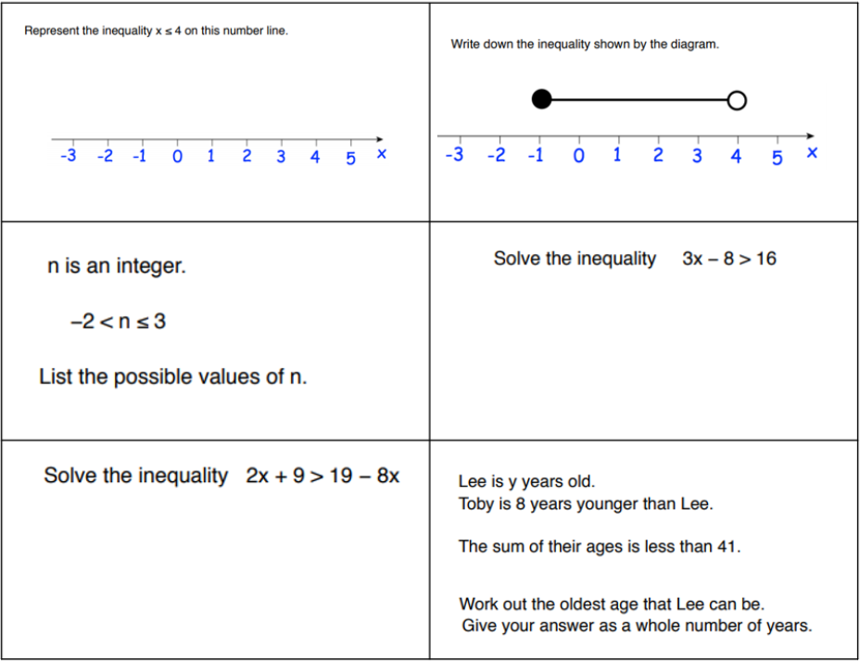
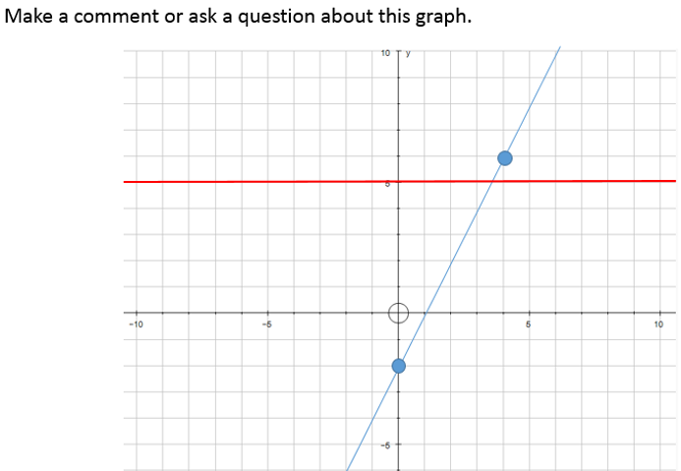
The start of the lesson
We have found the following two types of do now's (starters) are most effective.
Open do nows
The task should lead to generating discussions with new learning
The task should be accessible by all. If you’re struggling with this, simply adding “ask a question or make a comment” to a standard question can make it an open task.
Mixed questions do nows
Ensure the questions are differentiated (usually with increasing difficulty)
You should include a question on the topic you’re planning to deliver.

Slide 11
Create your own do now
Think about a lesson you recently delivered or are planning to deliver soon.
Spend a few minutes creating an open or mixed question do now for this lesson.
Use the sheet of paper provided for you to write the question or questions you will use.
Ensure it is able to lead to the learning outcome of the lesson.
If creating an open task, detail what range of responses you can expect to see.

Slide 12
Teacher explanations
Have high expectations of everyone in the class.
Do not disregard Foundation students when teaching higher content. Even if the content is not included in the Foundation GCSE, the skills learnt will be useful.
Plan your questioning.
Allow higher attaining students who show a good understanding of the topic you are delivering to start the work straight away

Slide 13
Resources for independent work
Have differentiated tasks ready that are suitable for all abilities in your class.
All the tasks do not have to relate to the exact topic you are teaching that lesson, e.g. If you’re delivering a lesson on frequency polygons and you have students who fully understand this topic. Have other tasks ready on pie charts or scatter graphs.
Promote independence and challenging oneself.
Students should be aware of how to choose a suitable task.
A lower attaining student should not just choose the easiest task.
Guide students to understand the correct level of challenge to work on.

Slide 14
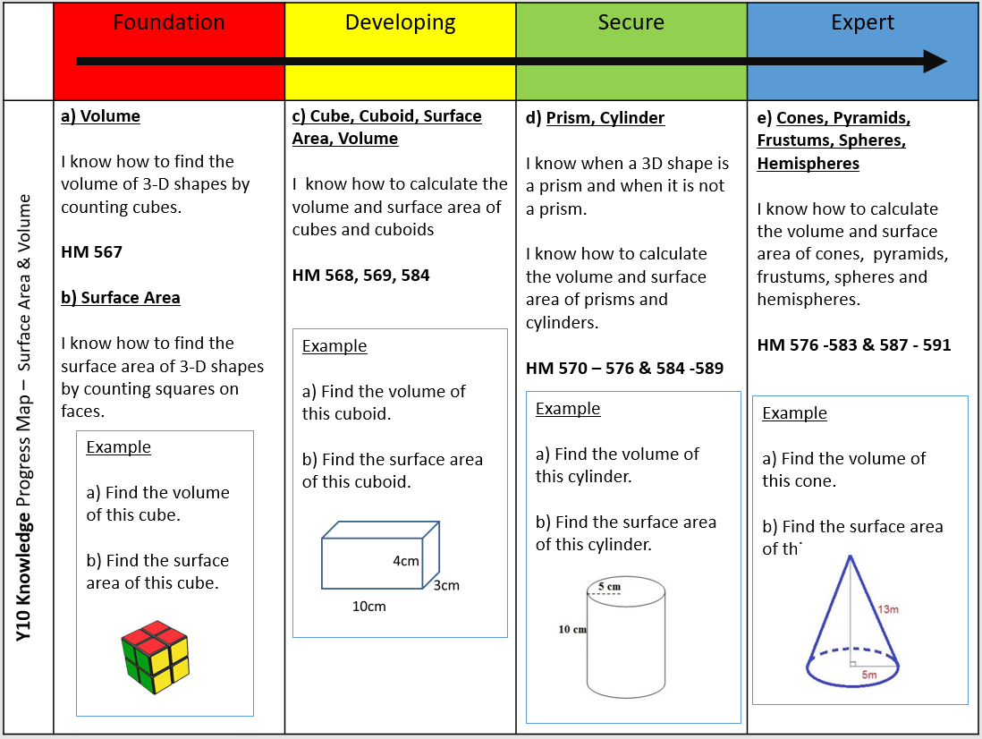
Progress Maps & Resources

Slide 15
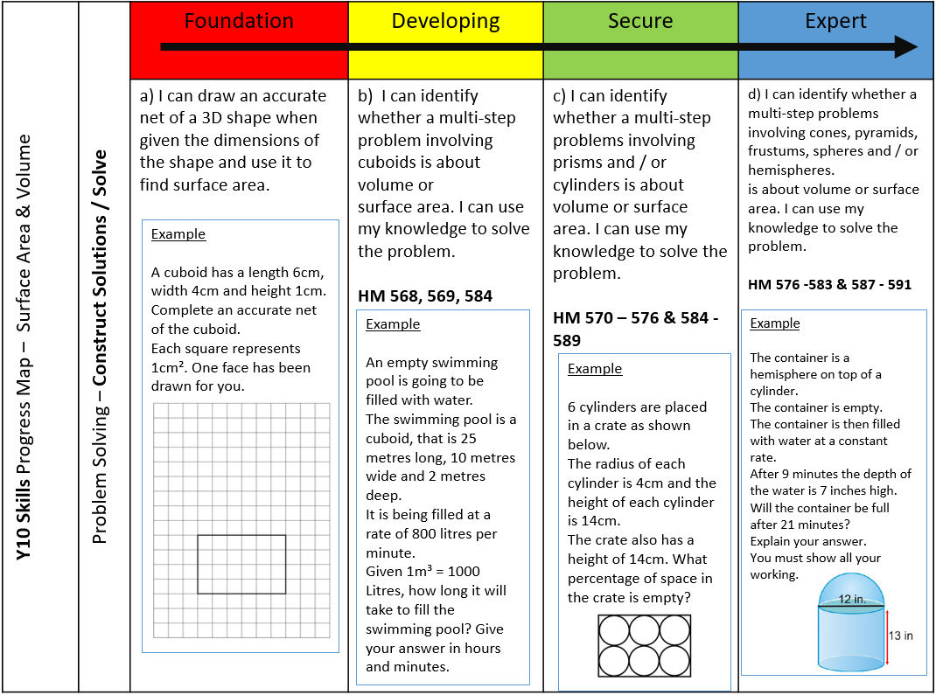
Progress Maps & Resources

Slide 16
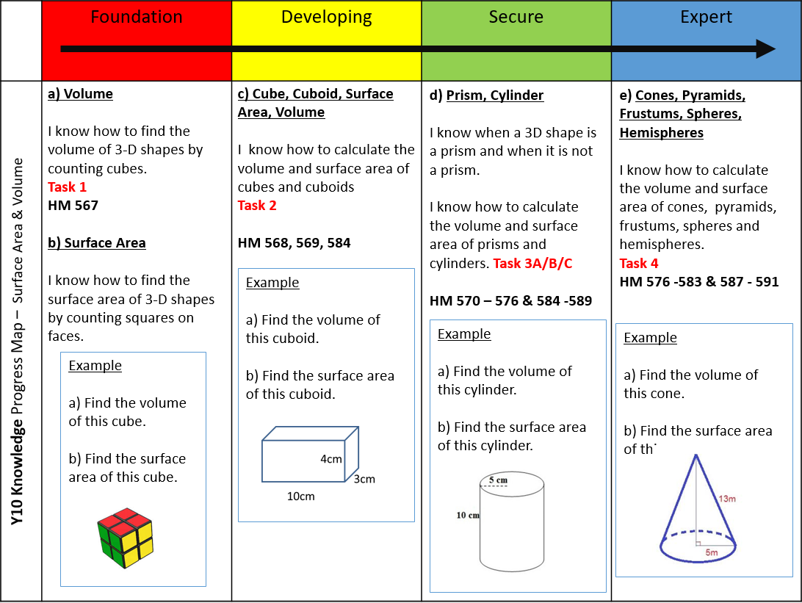
Progress Maps & Resources

Slide 17
! WARNING !
Do not dive head first into KS4 mixed attainment

Slide 18
ANY QUESTIONS?

Slide 19
Thank you for attending
Abdulkadir Mohamed & Tolga Demir

