Slide 1
To set or not to set at KS4?
Kate Gladstone-Smith and Paul McGarr
Joint Heads of Faculty
Langdon Park School
gladstonesmithk@langdonpark.org
mcgarrp@langdonpark.org
@kgladstonesmith

Slide 2
Grappling with some data…
Each pair of boxplots shows the data for two halves of a year 10 cohort.
Each half consisted of 4 classes
Have a look at the data and compare each pair of boxplots.
Focus on all quartiles in your comparisons.
What do they suggest about the top 25%, the lowest 25%?
In each case what do the two boxplots tell you?

Slide 3
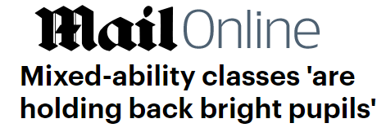
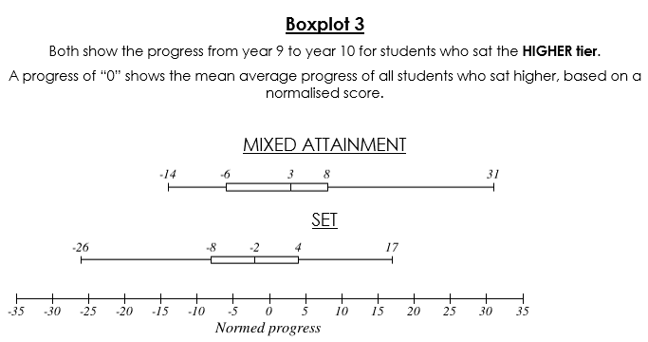
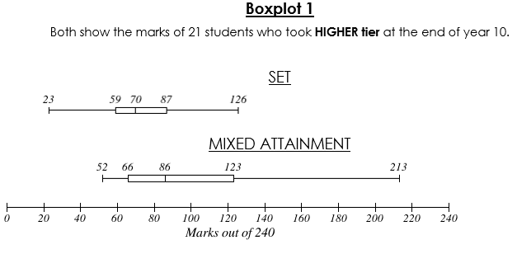
What does this Mean? HIGHER
Grammar Schools

Slide 4
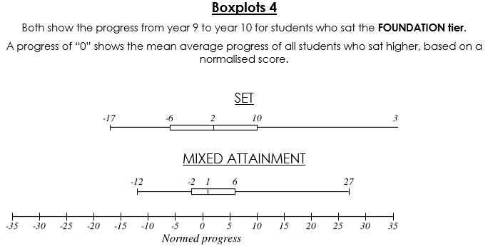
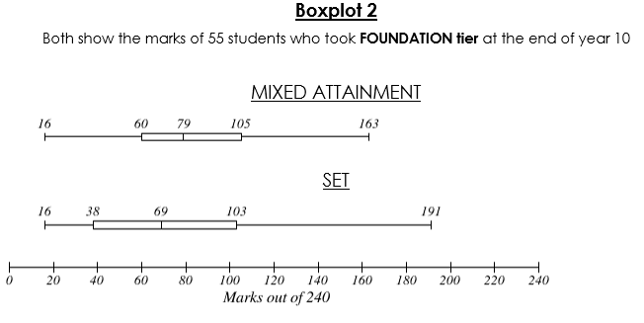
What does this Mean? FOUNDATION

Slide 5
Langdon Park
We teach year 7, 8 and 9 in mixed ability form groups.
And now, in response to this and other projects, we will be teaching year 10 in mixed ability groups.
For year 10 we have grouped the students into smaller classes of around 20 taking into account students’ personalities to create balanced teaching groups.
Before we share ideas to support mixed ability teaching it’s your turn to try out an activity we used with year 10 this year.

Slide 6
Over to you... Tetrahedra Tower
An activity for KS4
Get yourself into groups of fours.
Each member of the group needs to put together a tetrahedron using the nets.
Due to time constraints were are getting you to cut out a tetrahedron. We spend time in the teaching getting students to construct a net from scratch.

Slide 7
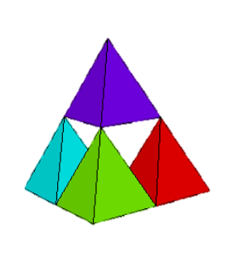
Over to you... Tetrahedra Tower
An activity for KS4
Work out the net for the 3D shape which fills the void and construct it accurately.
How might you extend and support this activity in the classroom ?

Slide 8
Ideas for scaffolding and challenging
How many other regular polyhedra are there?
Can you prove what you’ve found out?
Student teachers
Talking about accuracy
Find the surface area of your tetrahedra
Support for scoring and tabs
Properties of equilateral triangles and leading onto other triangles etc
Find the volume of your tetrahedra

Slide 9
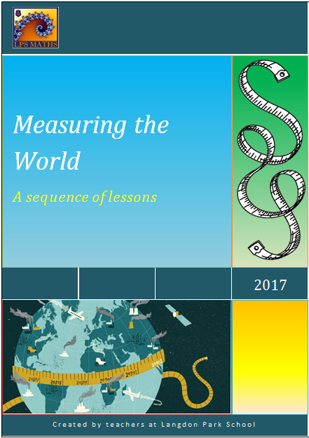
Fostering Mixed ability
We give a lot of time to collaboration to plan units of work.

Slide 10
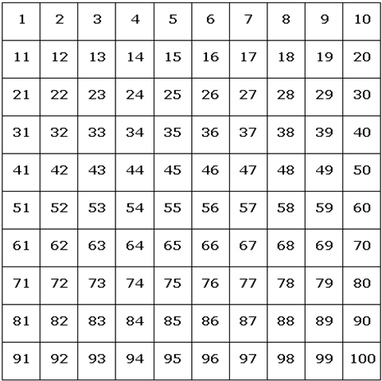
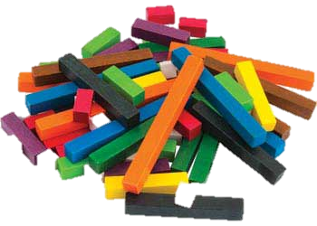
How we make it work
Support through manipulatives
Seizing opportunities and sending students down an unknown route
Planning and discussing pedagogic strategies to stretch and support a range of students
OPEN TASKS
RAGGED STARTERS
Stretch with new mathematical ideas
Frobenius Numbers

Slide 11
Fostering Mixed ability
We have a strong belief that both teachers and students should see themselves as mathematicians.
EXPECTATION

Slide 12
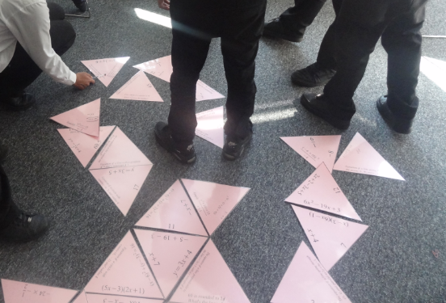
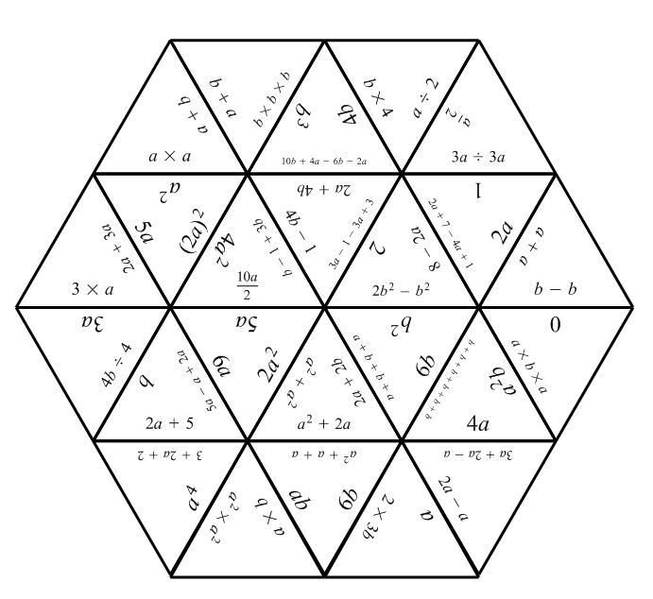
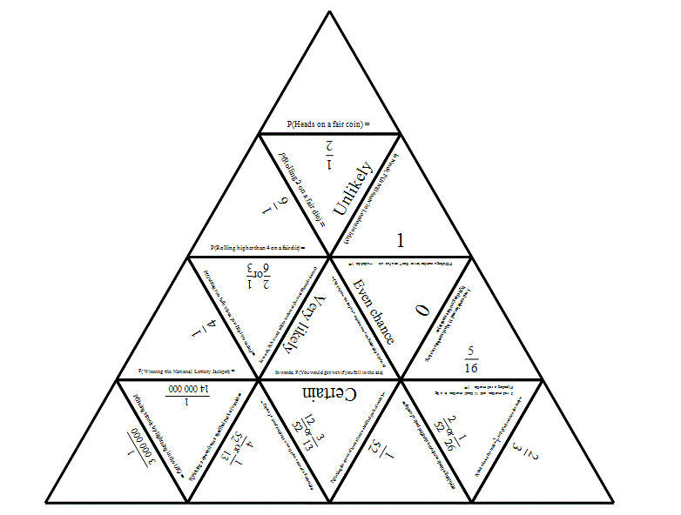
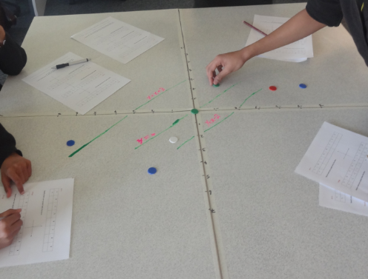
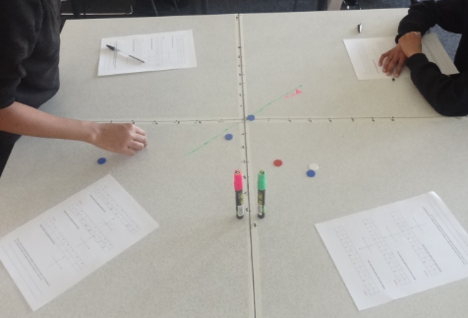
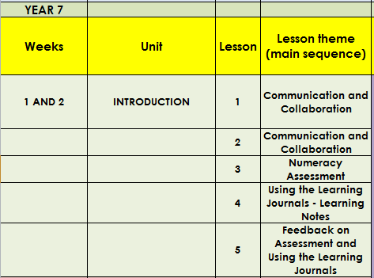
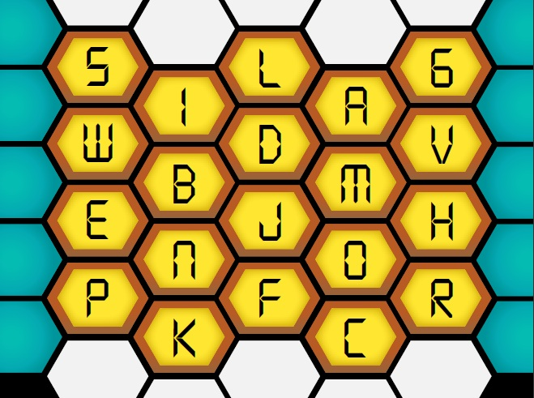
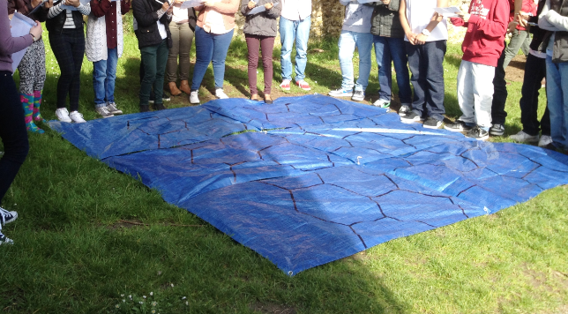
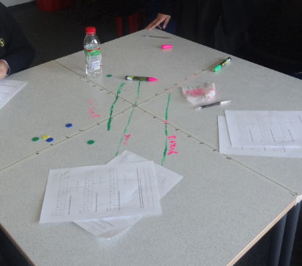
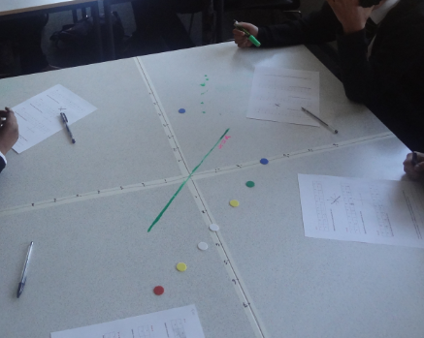
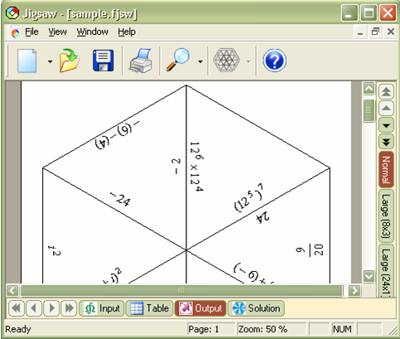
Fostering Mixed ability
We put a HUGE emphasis on working in a team and encouraging students to discuss mathematics

Slide 13
Questions?

